Slide 1
An NSS Audio-Visual
Library Presentation
Saving America’s Bats
Bat Conservation International and
The U. S. Fish and Wildlife Service
S403 49 Slides 2/06/2021

Slide 2
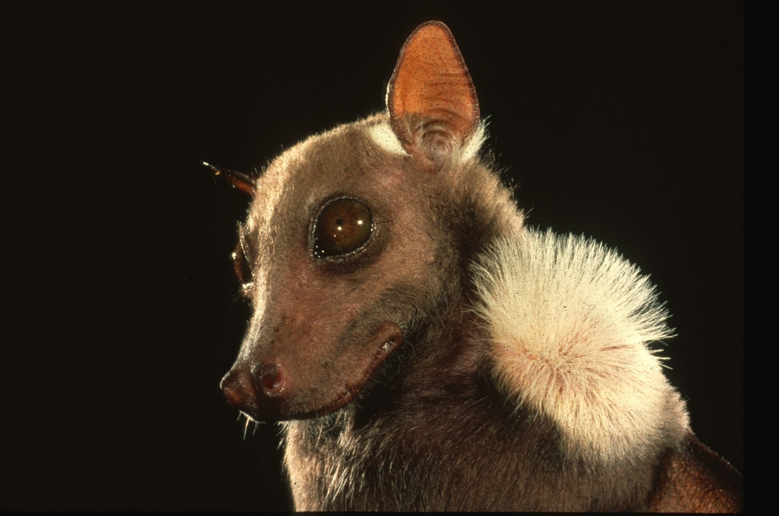
Notes:
There are nearly a thousand species of bats, inhabiting all but the most extreme desert and polar regions of the world. Their diversity and sophistication challenge our preconceptions. Few groups of animals are more beneficial or more misunderstood. Bats are not birds; they are mammals, and like all other mammals, the females bear live young. Bats form the largest and most vulnerable colonies of any warm-blooded animal. They reproduce at unusually slow rates, with females of most species producing only one young per year. Populations of many species are declining.

Slide 3
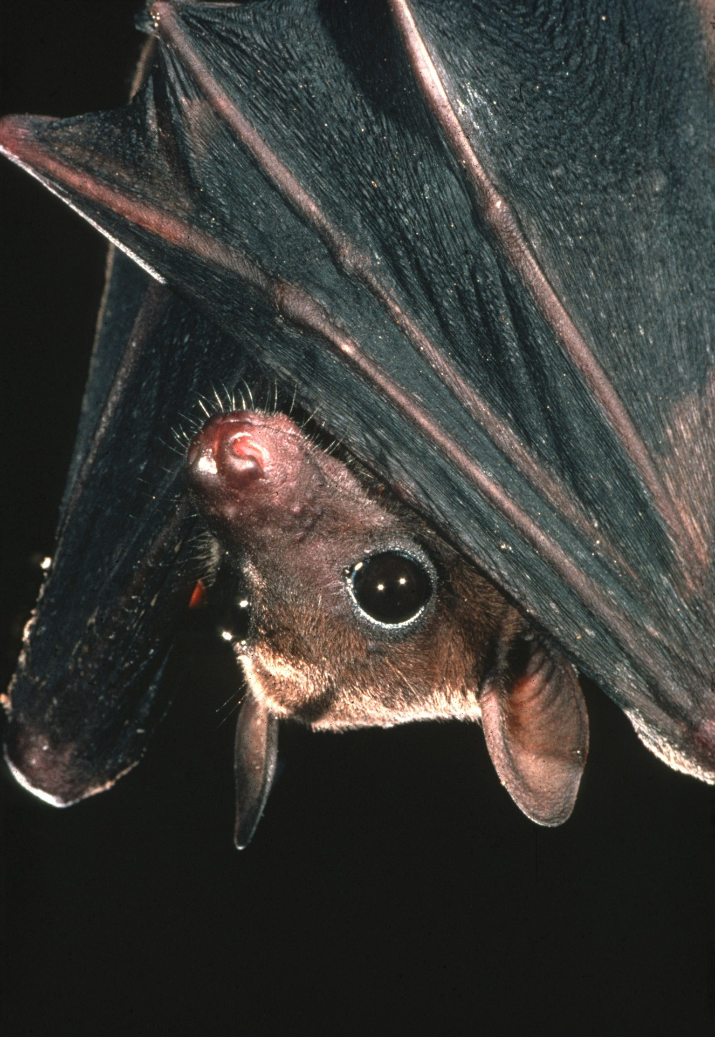
Notes:
Relentless persecution threatens remaining populations of bats worldwide. The underlying problem is one of widespread misinformation. If these fascinating and highly beneficial animals are to survive, people must learn to replace folklore with facts about bats.

Slide 4
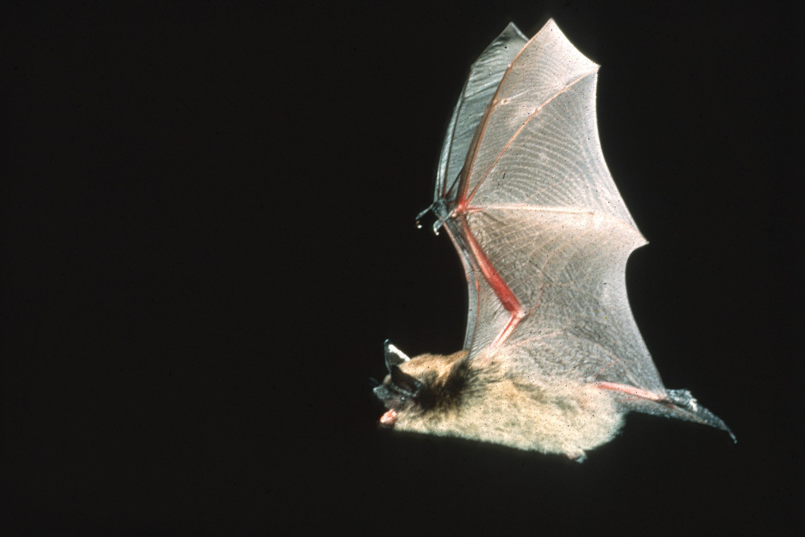
Notes:
Bats are the only true flying mammals. Contrary to popular belief, they are not rodents; they belong to their own order – Chiroptera. This means “hand wing.” They are similar to other mammals except that their hands and fingers are elongated to support the tough, stretchy skin membranes of their winds.

Slide 5
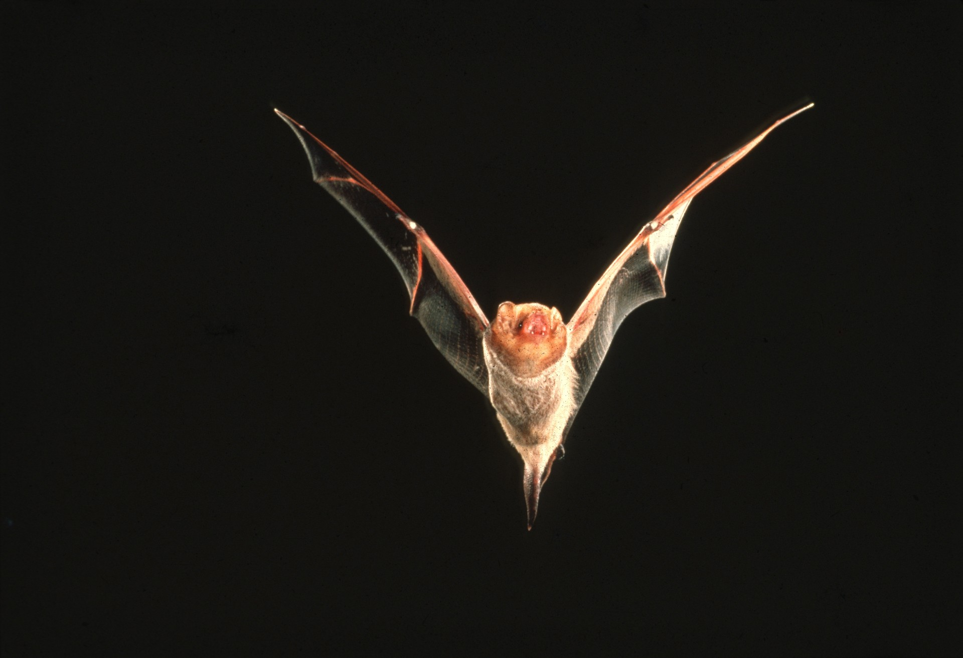
Notes:
Bats basically are tropical animals. However, the 40 species that occur in the U. S. can be seen in flight on warm evenings almost anywhere, from the largest eastern cities to the deserts of the southwest, and from the seacoast to the high mountains. Bats are most often seen feeding over ponds, streams, long forest edges, or around street lights.

Slide 6
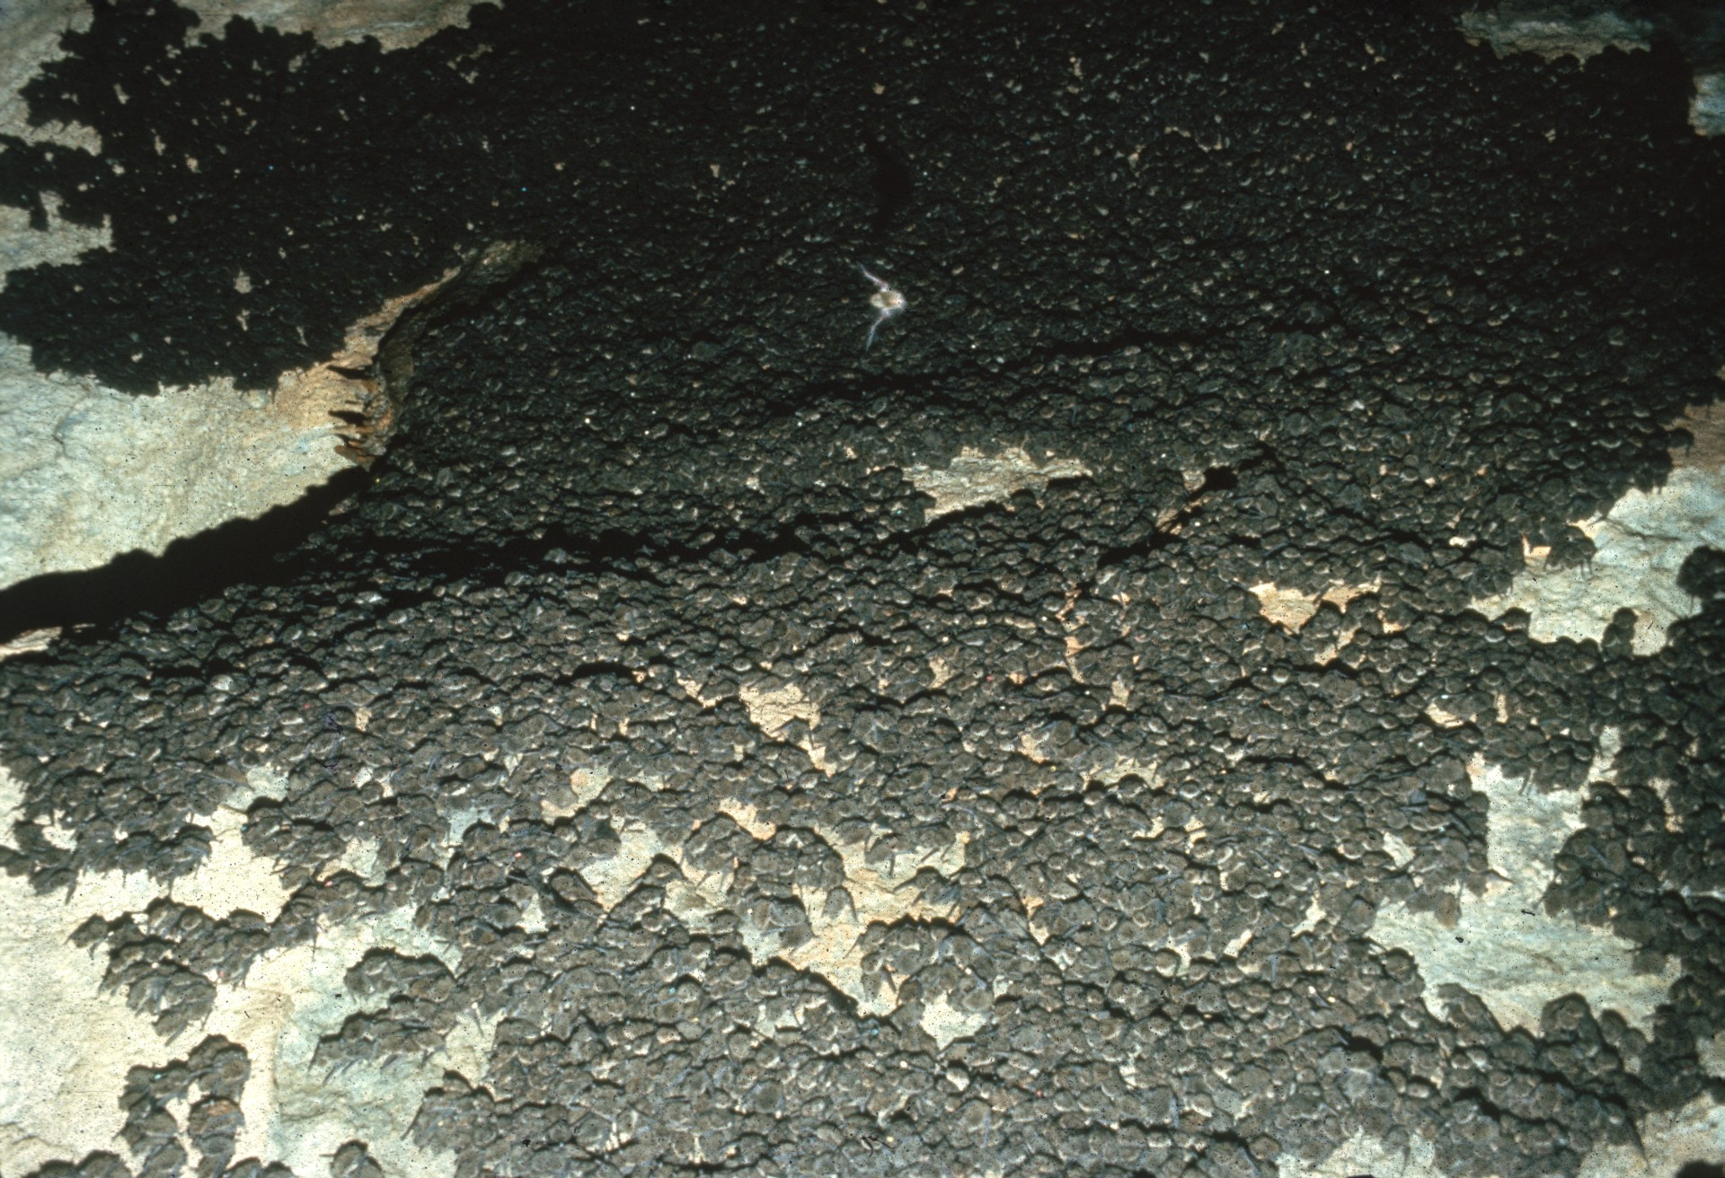
Notes:
In the daytime, bats seek shelter in a variety of places. Many species live in caves or hollow trees, some in buildings, and a few roost among the foliage of trees. Window shutters, loose bark, rock crevices, and various other nooks and crannies also shelter bats.

Slide 7
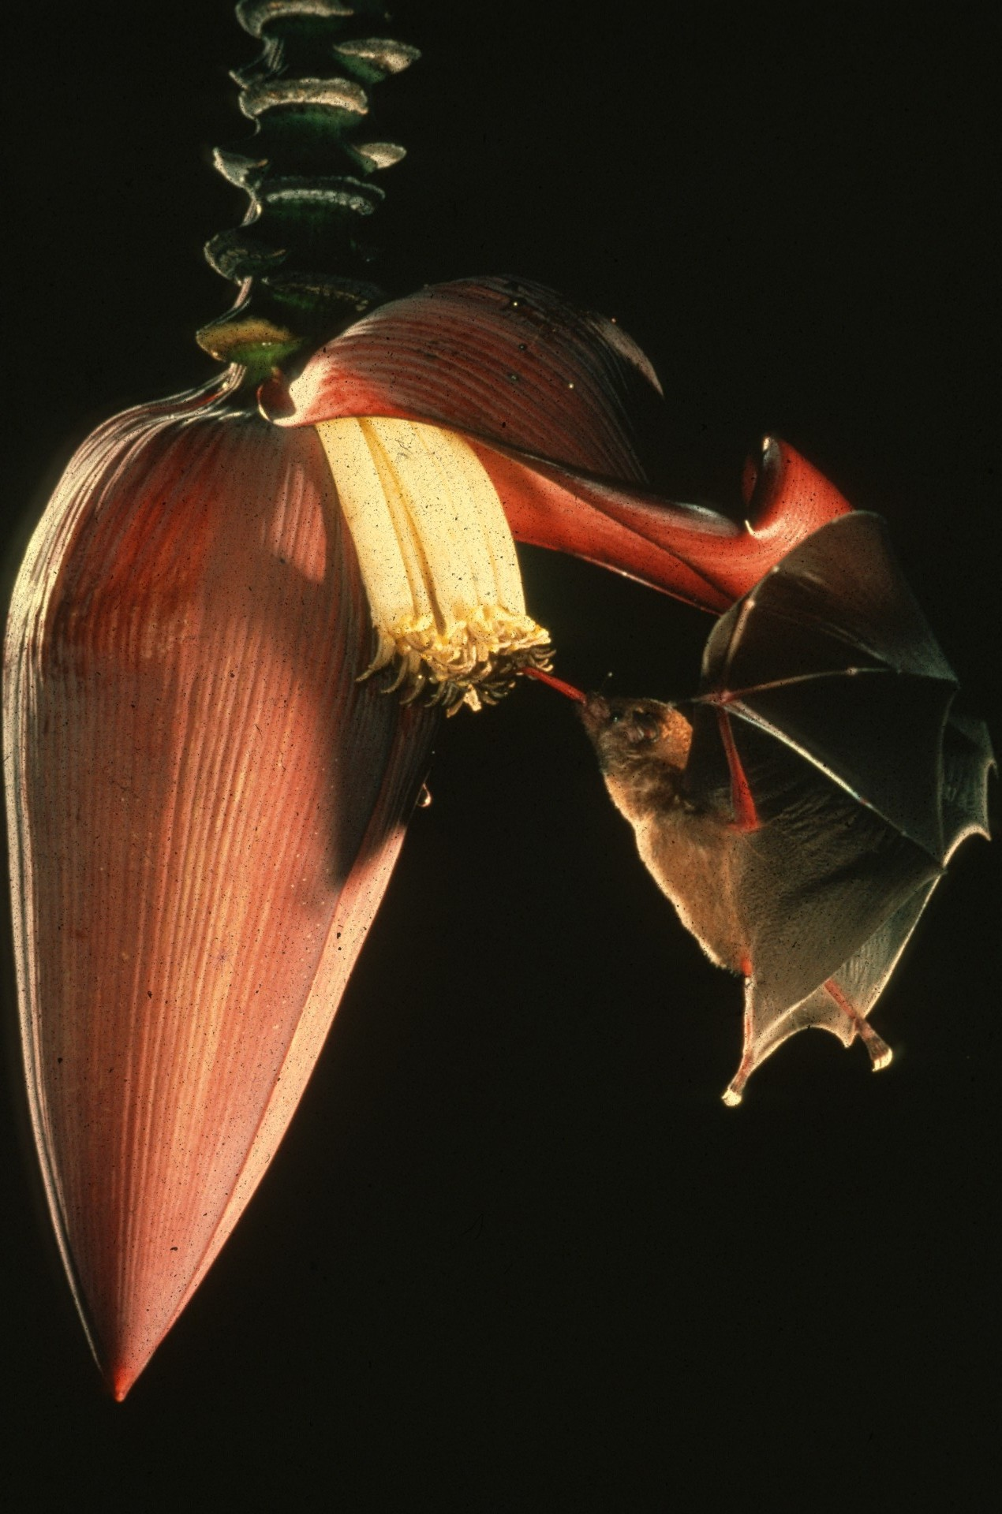
Notes:
Some bats, mostly tropical species, are highly specialized to feed on nectar and pollen. This bat is pollinating a banana flower that opens only at night and emits a special odor to attract the bat. Many bat-dependent plants offer special high calorie nectar and high protein pollen to sustain bats in their cross-pollination activities. More than 130 genera of tropical and sub-tropical trees and shrubs depend on bats for pollination.

Slide 8
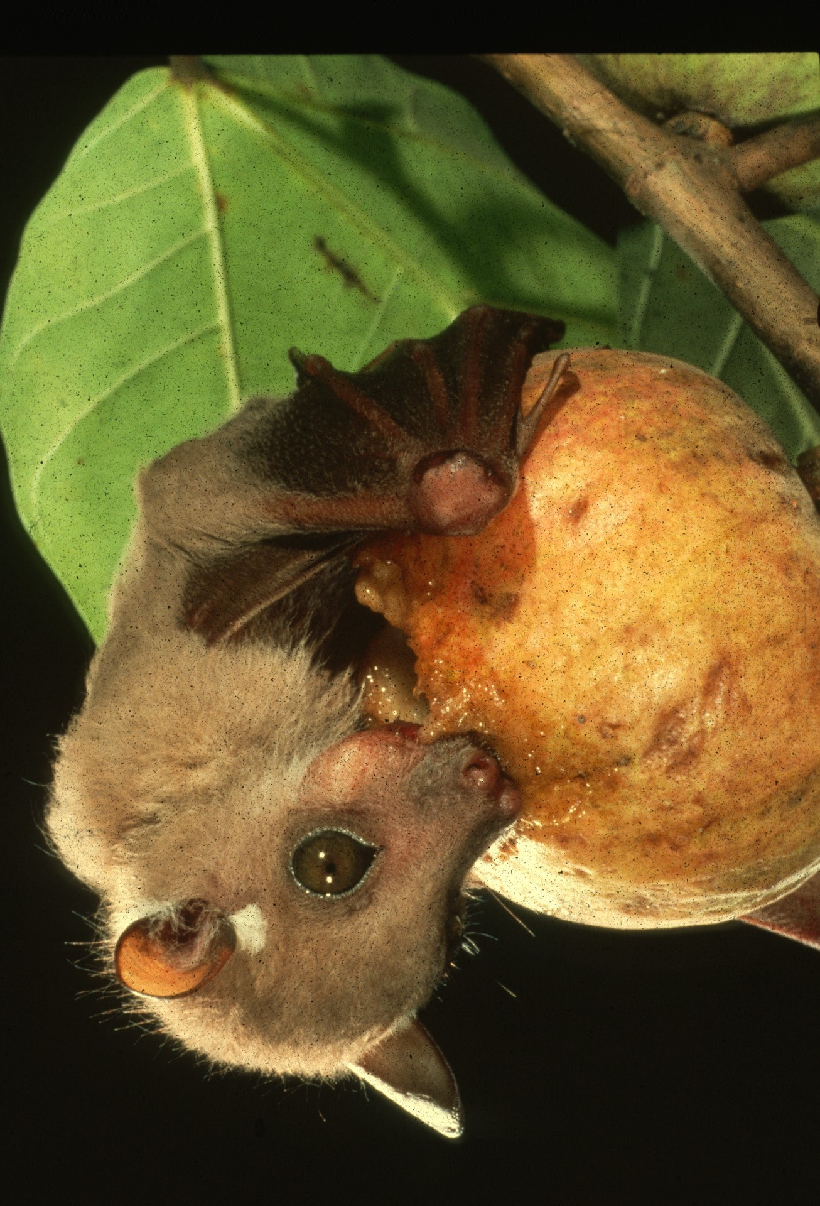
Notes:
Other tropical bats are adapted to eat fruit. Contrary to common misconception, they seldom damage commercial crops. They prefer strong-smelling, rope fruit in native forests. Such bats function as nature’s most important see dispersers for tropical plants. In some places they can account for as much as 90% of total dispersal for tree seeds. Many of these plants are of great economic importance.

Slide 9
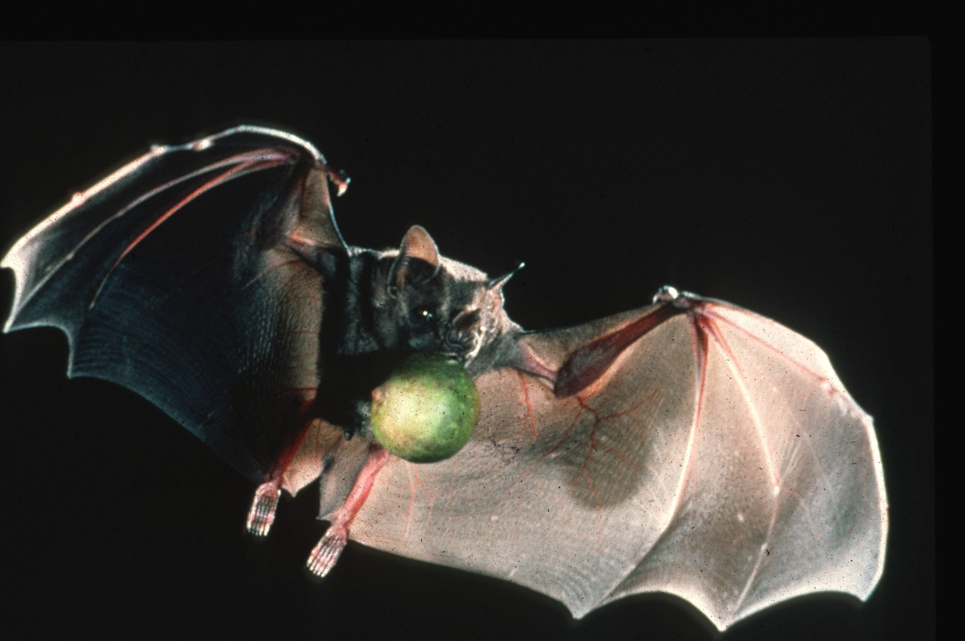
Notes:
Products from plants that originally depended on bats like this one include peaches, bananas, avocados, dates, figs, cashews, cloves, vanilla, and carob. Additional commodities include balsa and other valuable timber, kapok for life preservers and surgical bandages, latex for chewing gum and even tequila liquor.

Slide 10
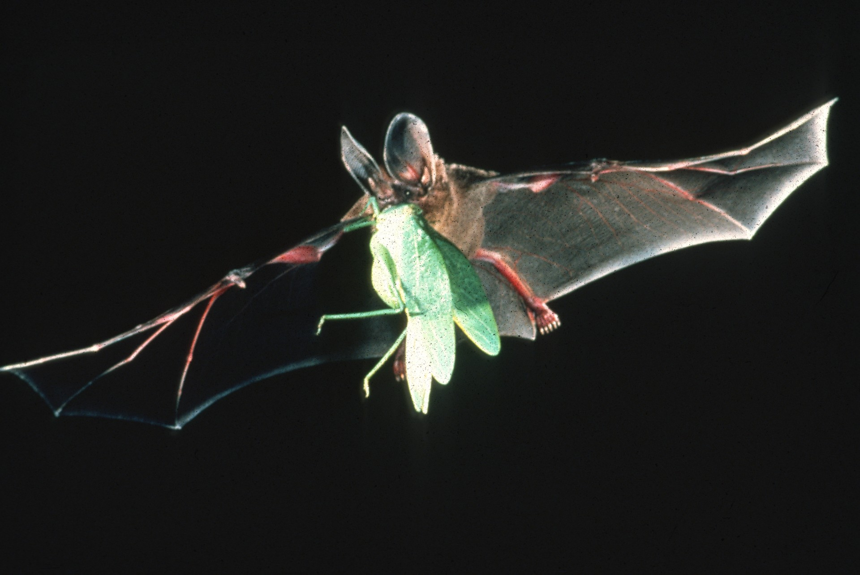
Notes:
Most U. S. bats – and, in fact 70% of all bat species – eat insects. Bats are the only major predators of night-flying insects, including many pests such as mosquitoes. When foraging, bats utter continuous series of ultrasonic cries and locate flying insects by the echoes. Once detected, large insects may be caught in the mouth, but most smaller ones are caught in a wingtip, flipped to a cup formed by the tail membrane, and then eaten.

Slide 11
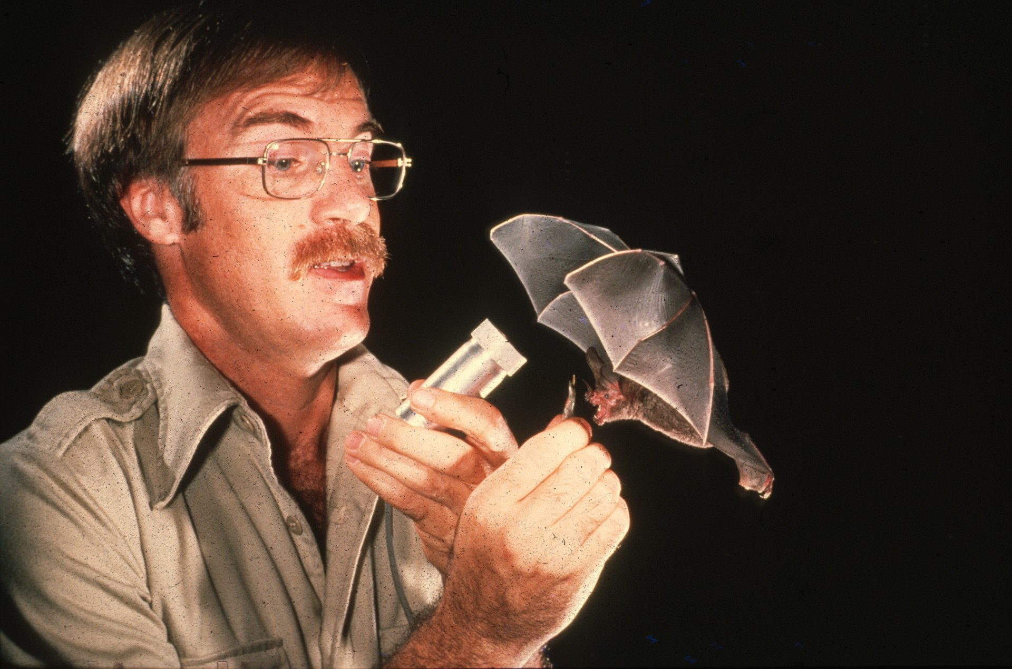
Notes:
Most bats are gentle, highly intelligent, and easily trained for scientific and medical research that benefits man. They have contributed to the development of navigational aids for the blind, to the development of vaccines, artificial insemination techniques and drug testing, and to studies of aging, disease resistance and blood circulation.

Slide 12
Notes:
In this lab, research may unlock secrets that will help solve problems of speech pathology. Despite their benefits, bats often are intensely feared. This is understandable.

Slide 13
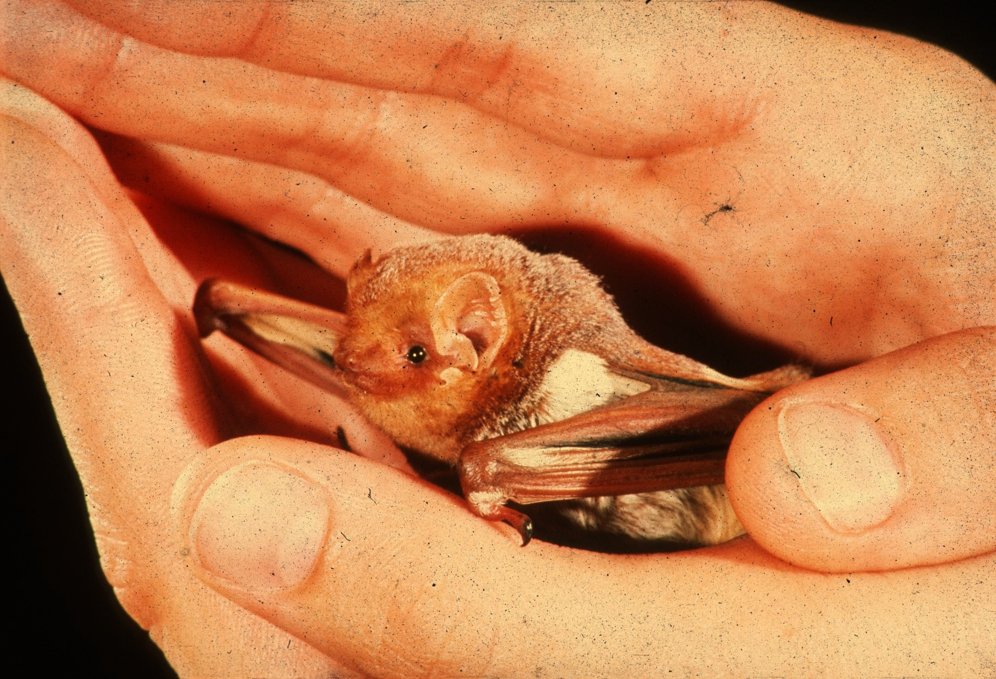
Notes:
Bats in our part of the world are small, secretive, and usually seen only at night. If they swoop close to our heads to catch a mosquito, we may wrongly assume that we’ve been attacked. Our fears have been conditioned by centuries of folklore, sensational news reporting, and more than 130 films about the mythical Dracula. But despite all the cultural bias and bad press, bats are not aggressive and they seldom transmit disease to man. When people are bitten, it is normally because they have foolishly picked up a sick, grounded bat that bites in self-defense. Any bat that can be picked up should be assumed to be sick and avoided. Mortality statistics show that even our own pet dogs are far more dangerous. Contrary to popular misconceptions, most bats are harmless and highly beneficial. Fewer than half of one percent contract rabies, and even those individuals are rarely aggressive. Bats are certainly not scary, dirty, or blind. They do not get caught in peoples’ hair, infest homes with bedbugs or attack pets.

Slide 14
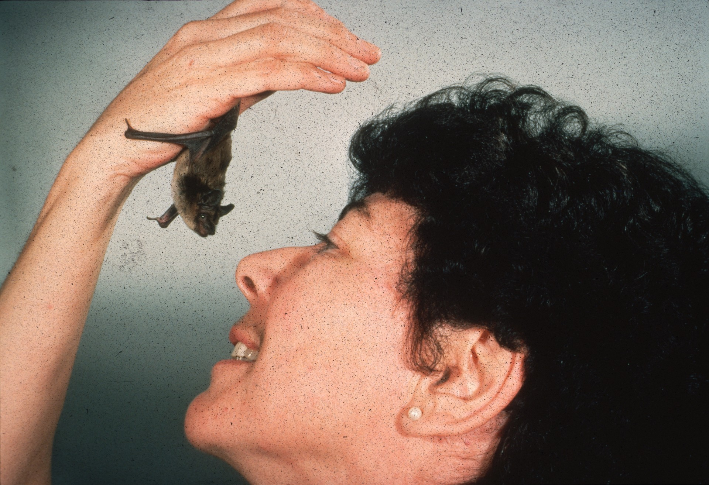
Notes:
The zoo keeper shown here has made friends with a bat rescued from house painters who had needlessly killed all its roost mates. Bats can be tamed and even trained easily, but they have special needs. And, because inexperienced people would most easily find and capture more vulnerable individuals that are sick and potentially dangerous to handle, it is not advisable to try to keep bats as pets. This simple precaution applies to other wildlife as well.

Slide 15
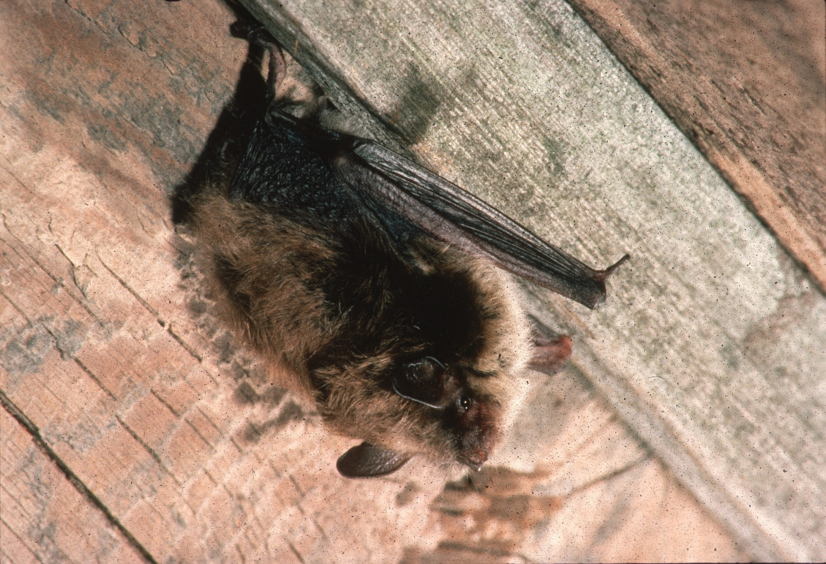
Notes:
In a few instances, large colonies of bats many become a problem if they roost in buildings. When they must be evicted, the only safe, permanent solution is to build them out by sealing roost entrances after the bats’ nightly of seasonal departure. Windows, doors, vents, and chimneys should be screened and draft guards placed under attic doors to keep bats and other wildlife out of human living quarters. Poisoning bats is ill-advised. Pesticides used against bats are costly, ineffective, and potentially hazardous both to man and the environment. Their use serves to increase, rather than decrease, public health risks. A peaceful coexistence with bats may be advantageous. Many people who have bat colonies claim to have fewer mosquito problems around their homes and enjoy watching their bats hunt for insects.

Slide 16
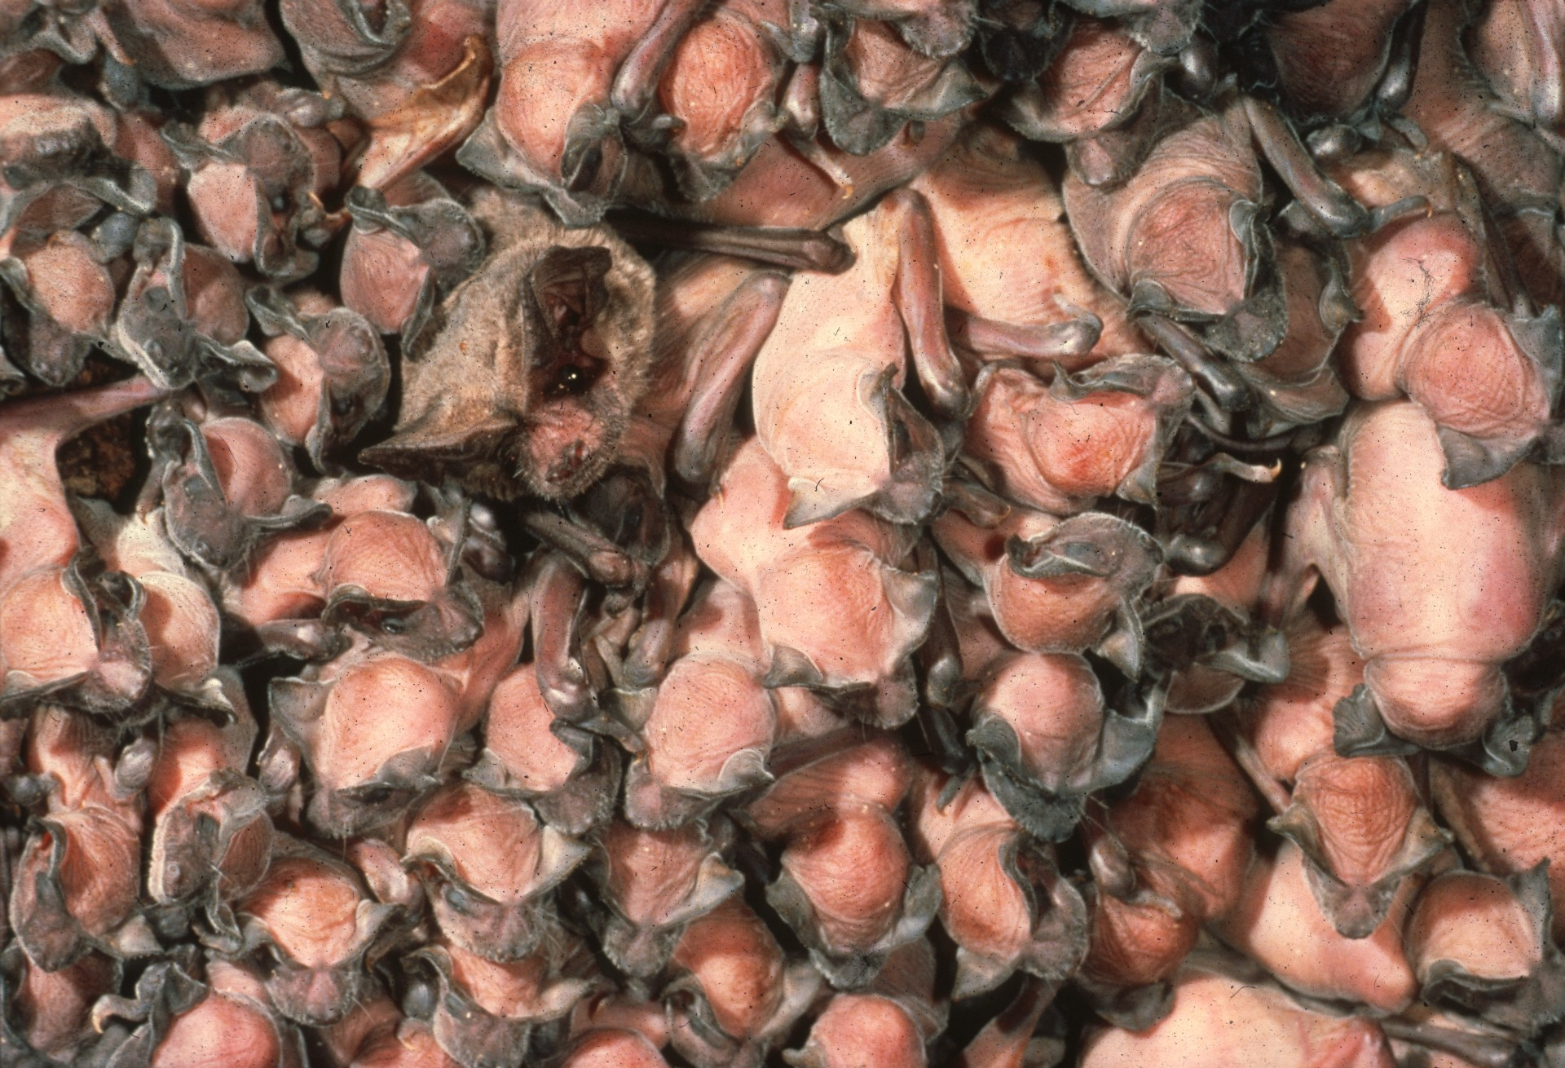
Notes:
Now let’s take a closer look at some of the bat species in the U. S. Bats mate in fall and winter, and the female of most species retains live sperm in her body until Spring, when ovulation and fertilization occur. Most pregnant females congregate in nursery colonies ranging in size from a dozen or so to several million bats. Young are usually born in May or June, when insect populations are at their peak. When the mother emerges in the evening to feed, the young are left behind, where they usually form clusters. Mothers return at intervals throughout the night to nurse their babies. Young bats first fly in about 3 weeks and are weaned soon after.

Slide 17
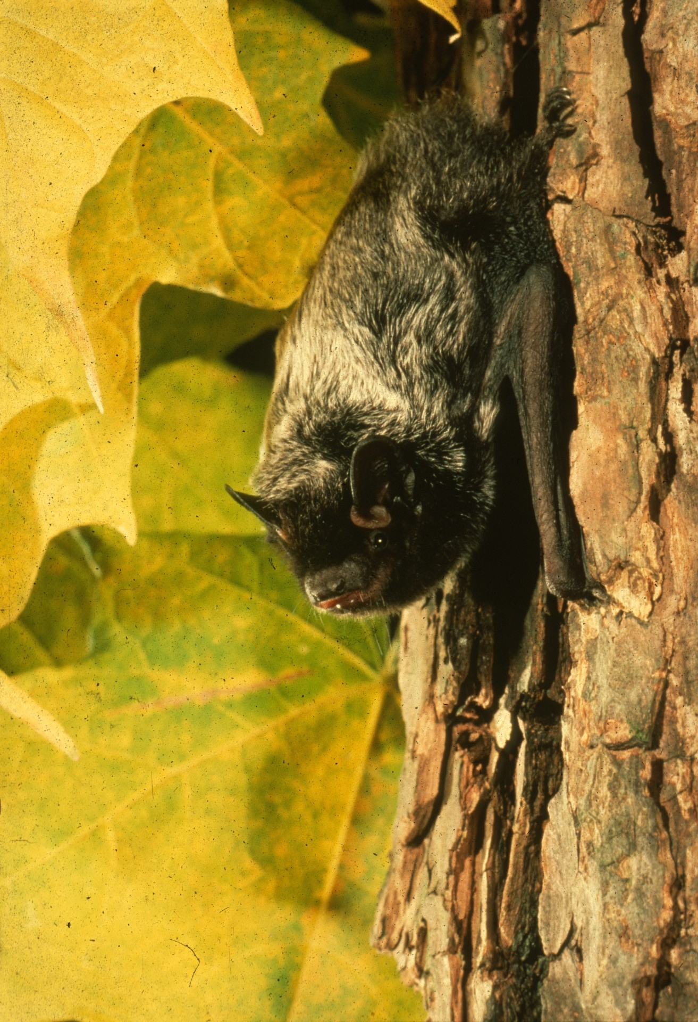
Notes:
This Silver-haired bat is one of the most widely distributed of U. S. bats. It is a solitary, tree-dwelling animal that is hard to see because its beautiful black, silver-tipped fur serves as camouflage. It roosts under tree bark or in old woodpecker holes. In winter, it flies south to hibernate in milder climates, often in deep crevices in cliff faces. At least one individual seems to have over-shot its mark when it landed in Bermuda, a 650 mile flight over open ocean.

Slide 18
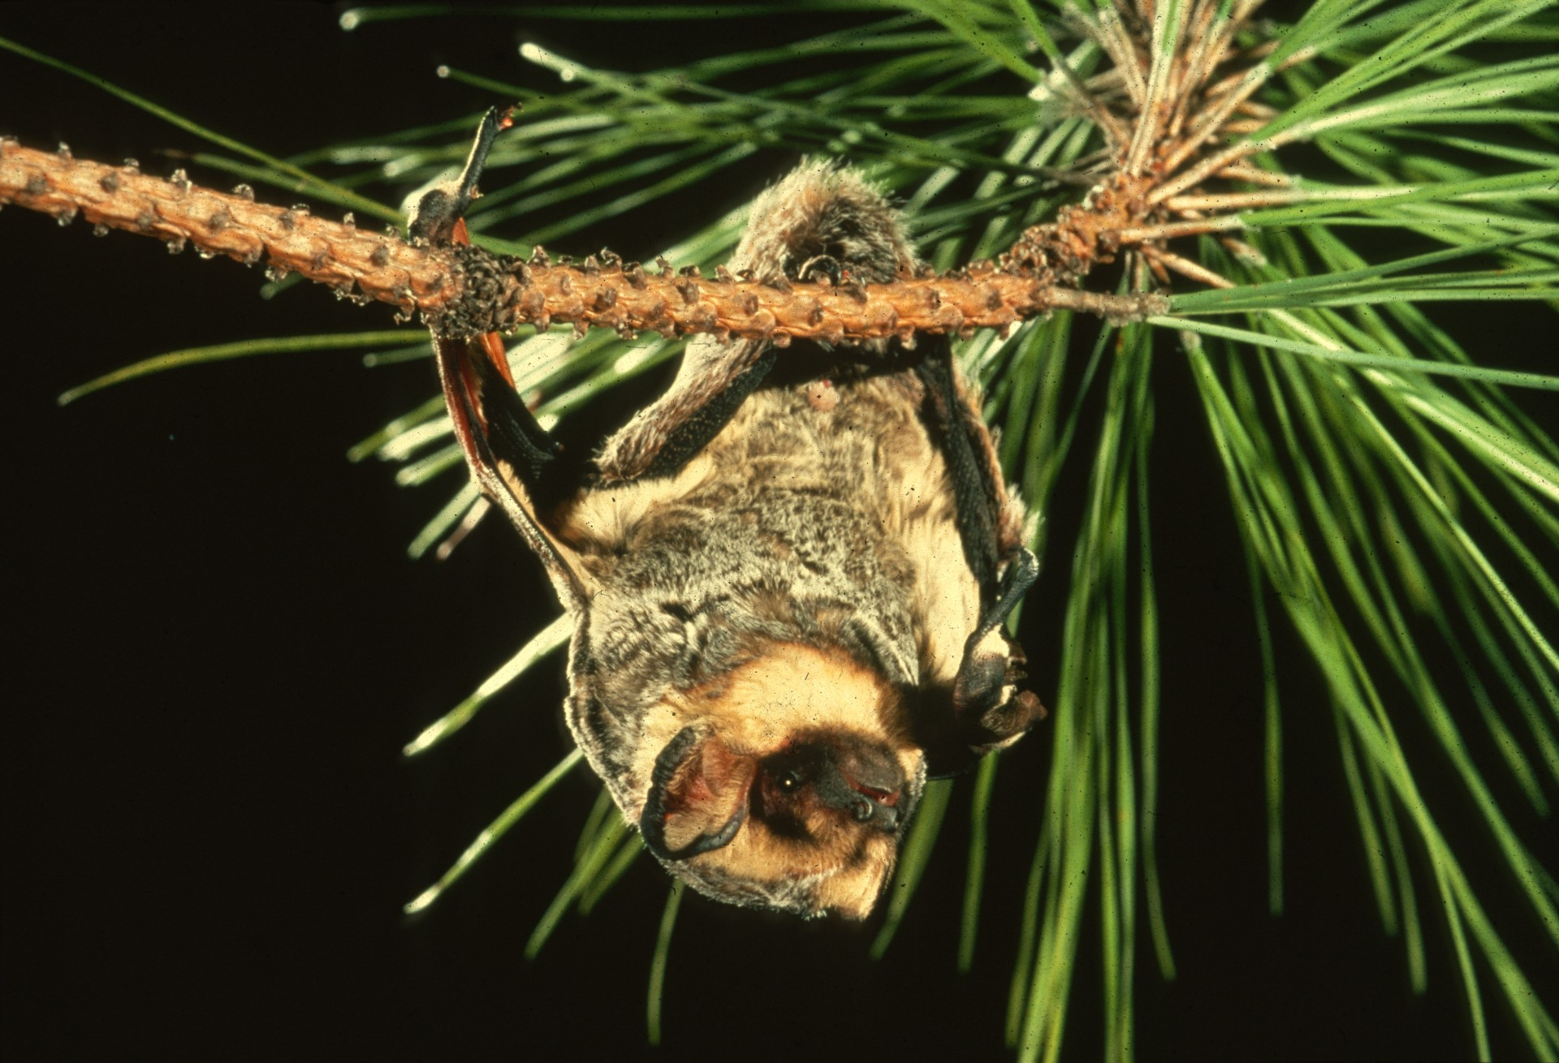
Notes:
Hoary Bats are also solitary and migrate south in fall. For several years, one Wisconsin Hoary Bat returned to the same branch of the same blue spruce tree each spring to give birth and rear her young.

Slide 19
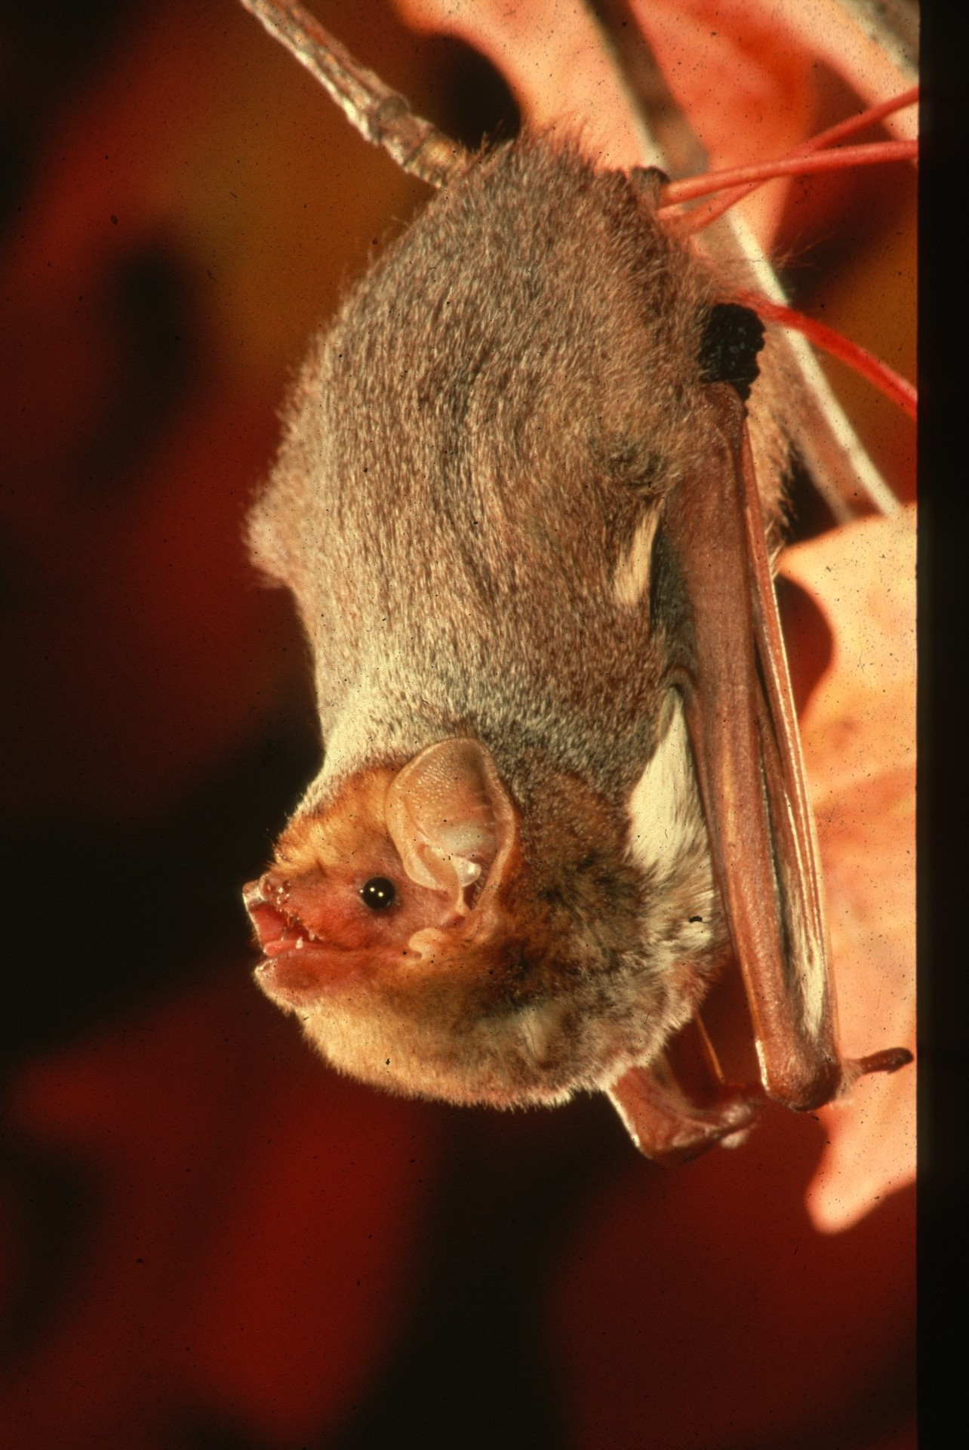
Notes:
This is a Red Bat. When asleep, it hangs by one foot and is easily mistaken for a dead leaf. Red Bats also fly south to hibernate, apparently outdoors in below freezing temperatures. They curl their furry tail membranes down over their bodies to keep warm. In summer, they may be seen feeding above street lights.

Slide 20
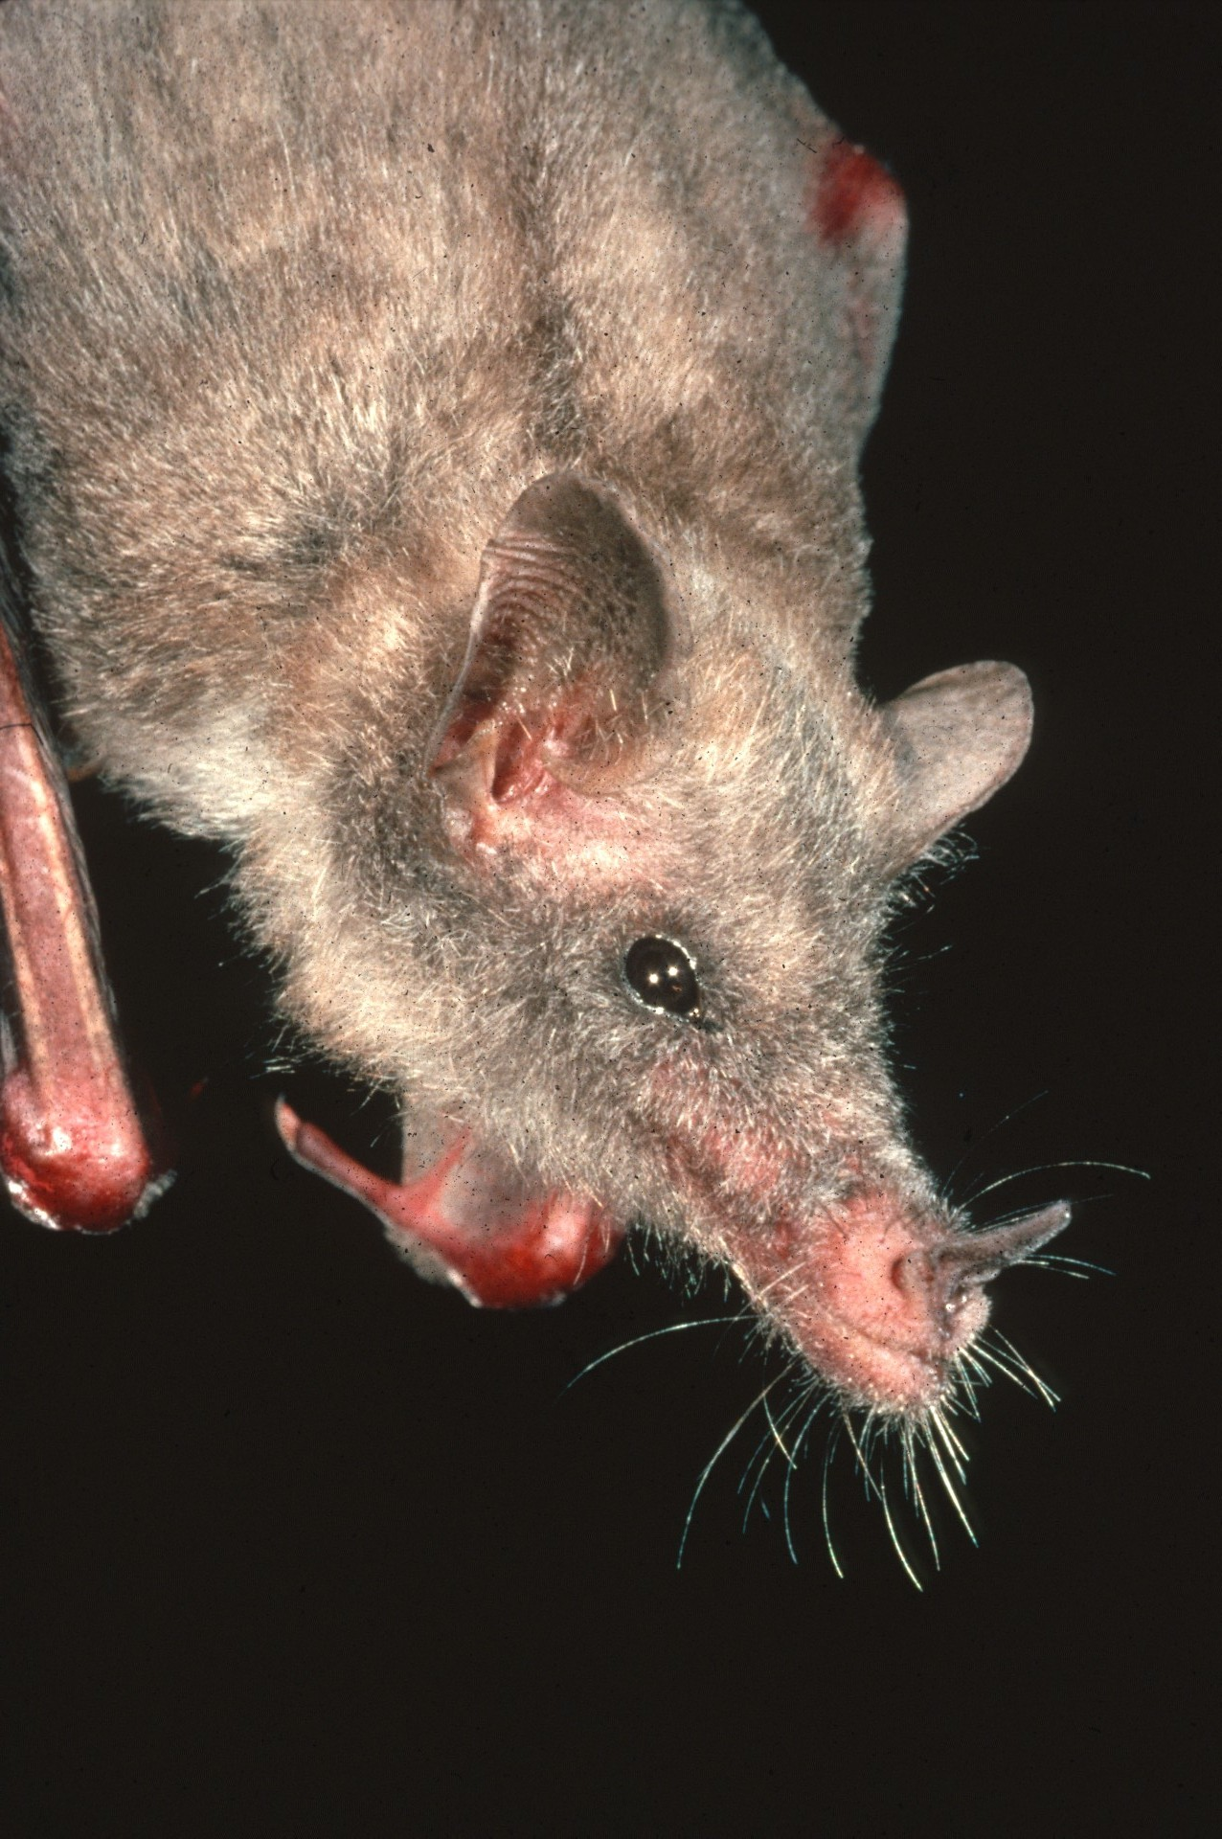
Notes:
Highly specialized nectar-eating bats of the southwest pollinate Saguaro and Organpipe cacti that are important to desert ecosystems. Nectar bats also pollinate the Century plants from which we get sisal fiber for rope and even tequila liquor.

Slide 21
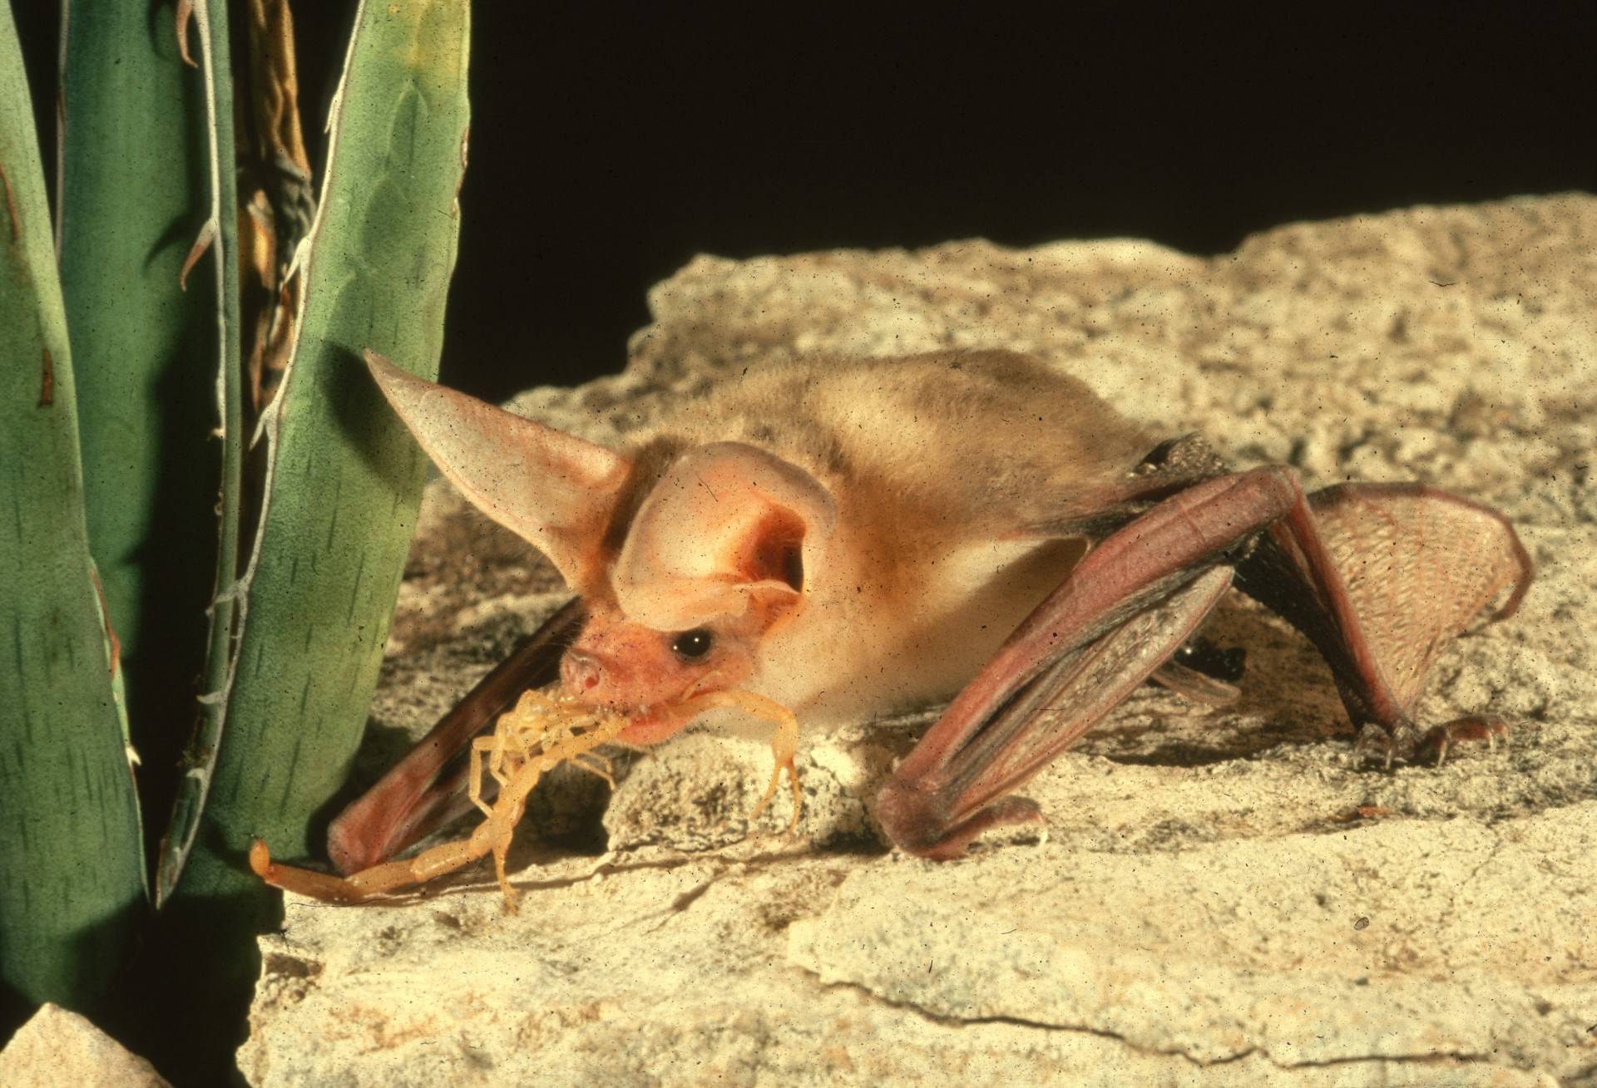
Notes:
The Pallid Bat, another southwestern species is unique for its habit of catching scorpions, unharmed by their stings. Bats have developed varied food preferences, allowing several species to live in the same area while minimizing competition for food. A few bats, like this one, forage for prey on the ground. Some glean insects from foliage, while most capture aerial prey.

Slide 22
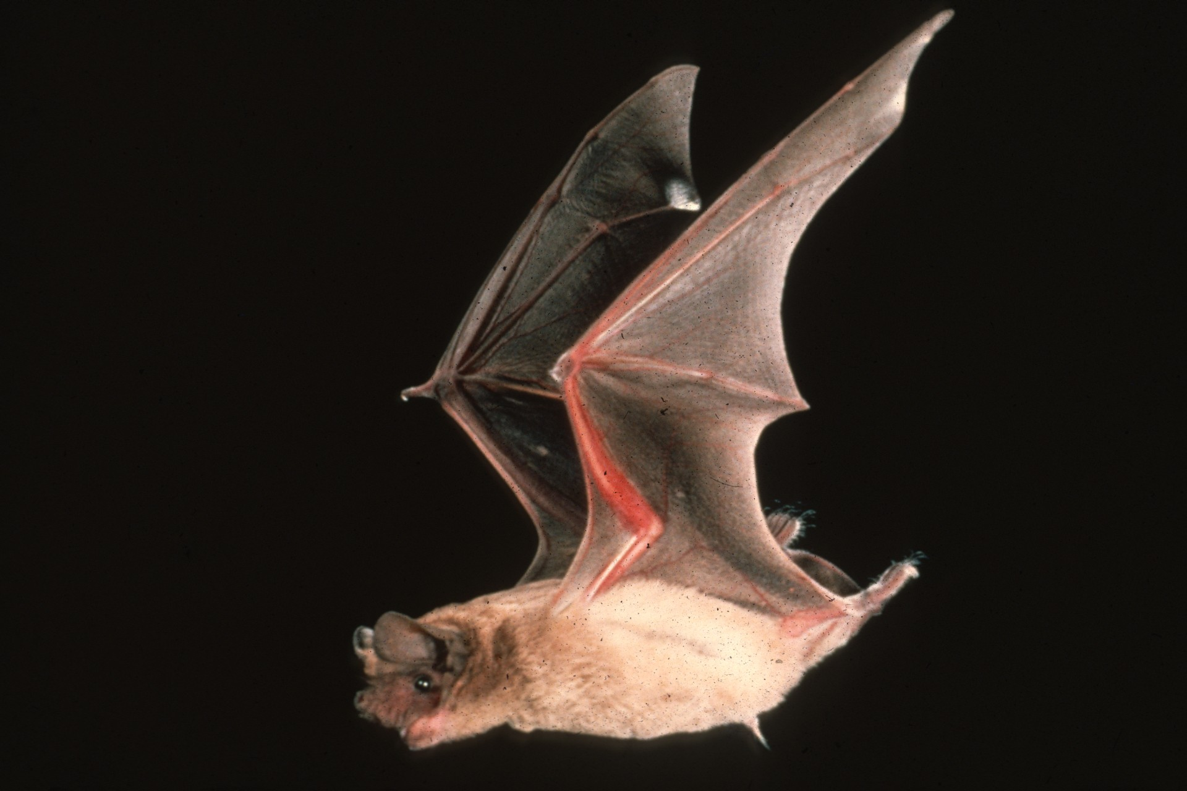
Notes:
Free-tailed Bats, also of the southwest, are truly remarkable. These accomplished fliers attain speeds of at least 40 miles per hour. Air Force radar has tracked great flocks to altitudes as high as 10,000 feet. These bats migrate up to 1,000 miles to reach their winter quarters in Mexico. Single huge colonies may cover thousands of square miles and catch more than a quarter million pounds of insects nightly as they disperse over surrounding farmland. Cave-dwelling bats, like Free-tails, are the major nutrient suppliers for cave ecosystems that make life possible for many unusual animals.

Slide 23
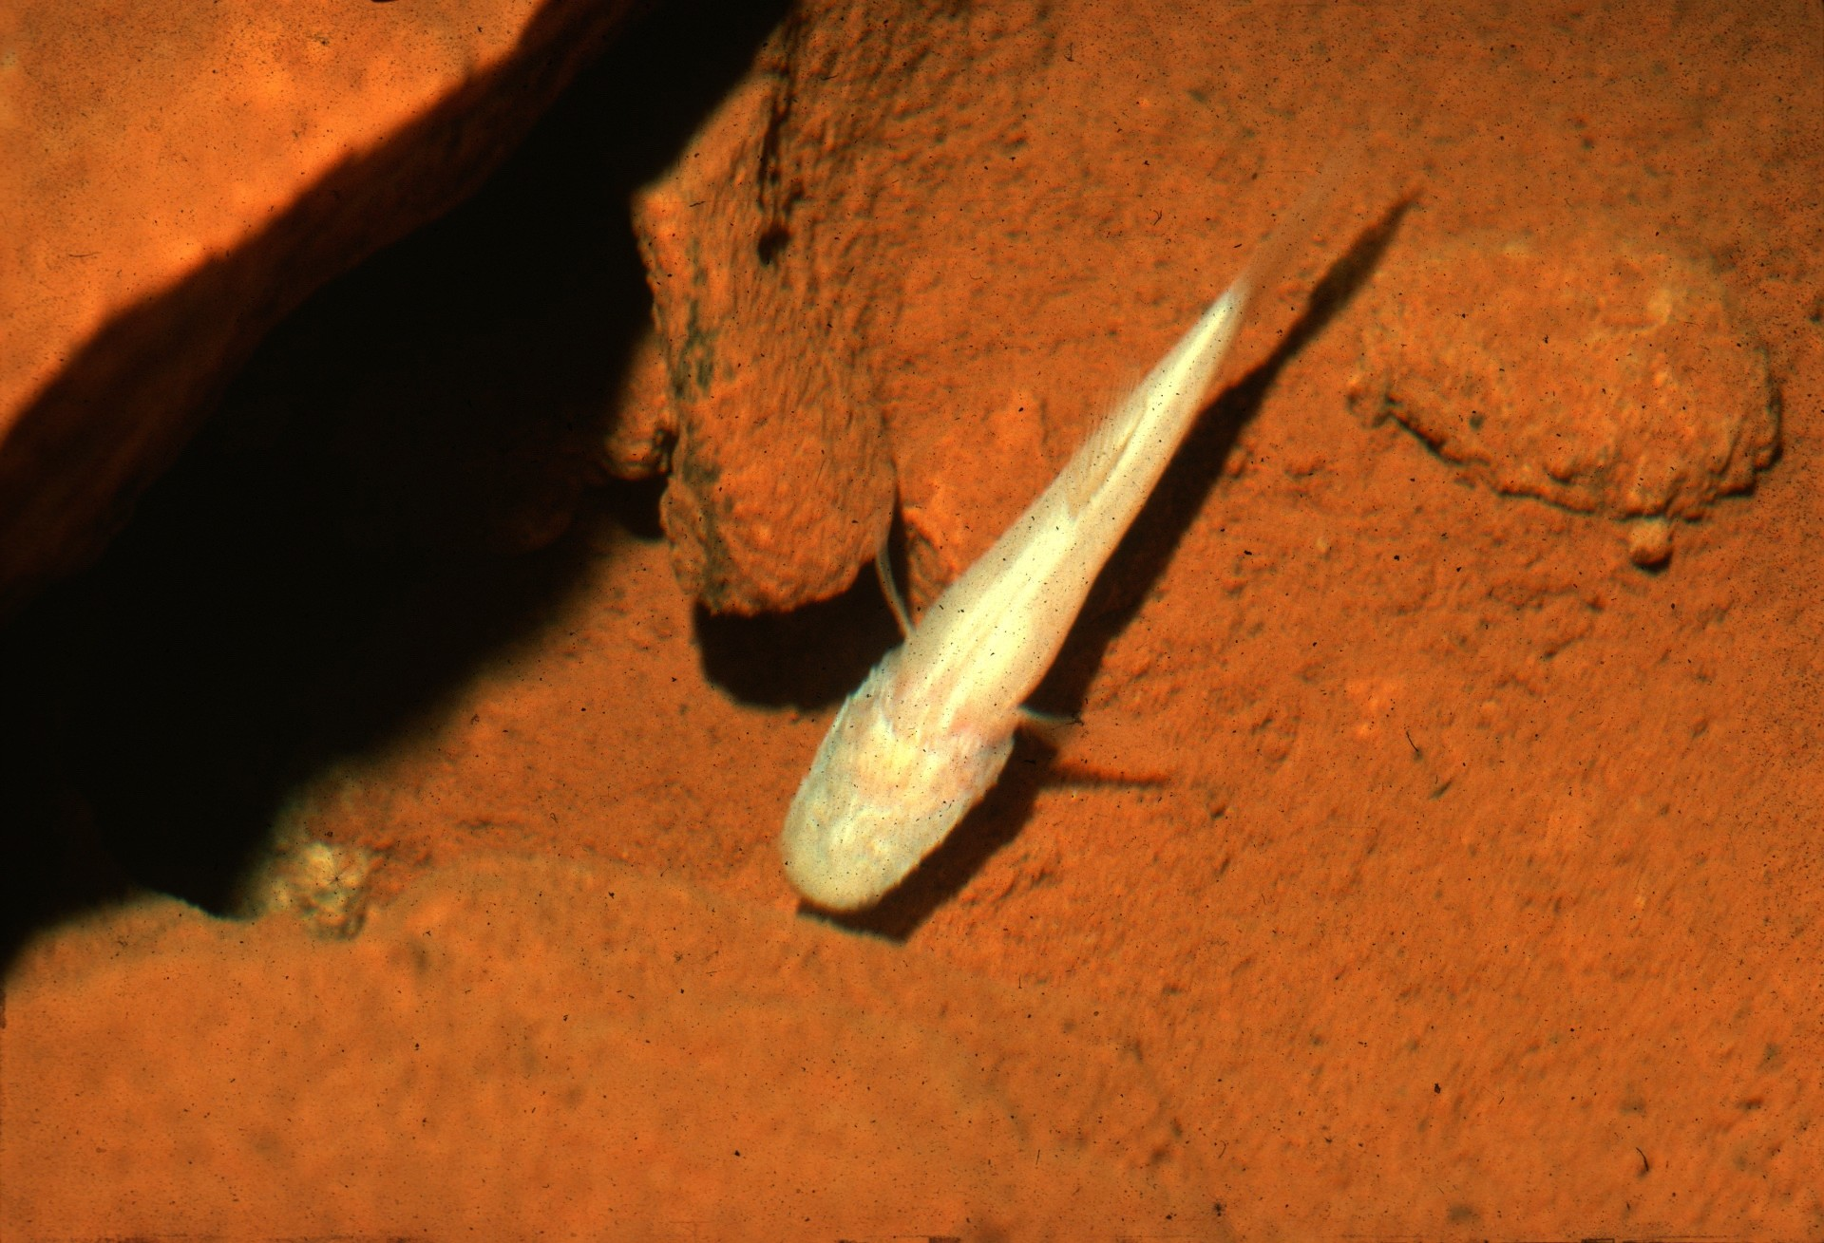
Notes:
This eyeless cave-dwelling fish is exclusively adapted to life in total darkness. Cave explores and researchers alike are intrigued by the life histories of such creatures.

Slide 24
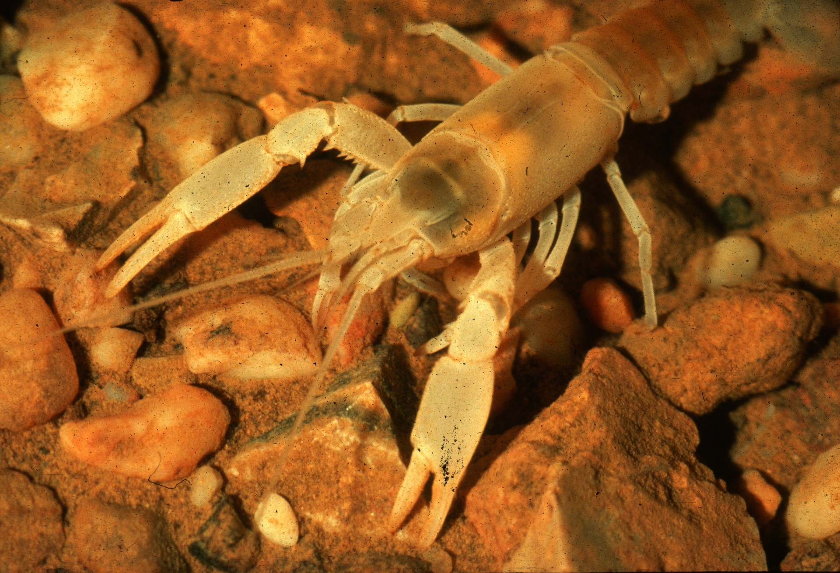
Notes:
This blind crayfish and many other unique organisms are collectively threatened when bat populations dwindle.

Slide 25
Notes:
The Free-tail Bat colony at Carlsbad National Park, New Mexico, provides an attraction for park visitors, who come to marvel at the twilight emergence of some 300,000 bats. No visitor has ever been harmed by these bats.

Slide 26
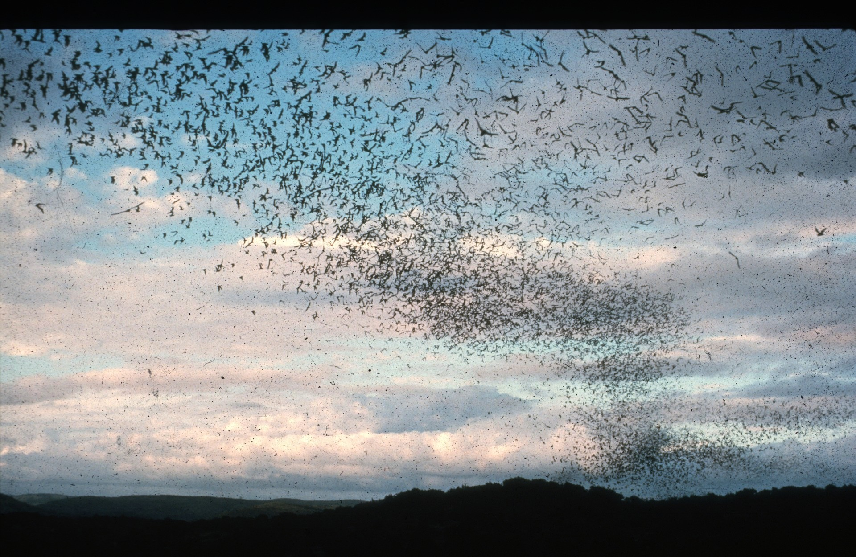
Notes:
For bats like Free-tails to continue their beneficial services to the environment, large colonies, not mere remnant populations, must survive. But large colonies of bats worldwide are being destroyed. Curing the last two decades, Free-tail populations have declined by as much as 99% in some parts of their range, mostly due to poisoning from the overuse of agricultural insecticides.

Slide 27
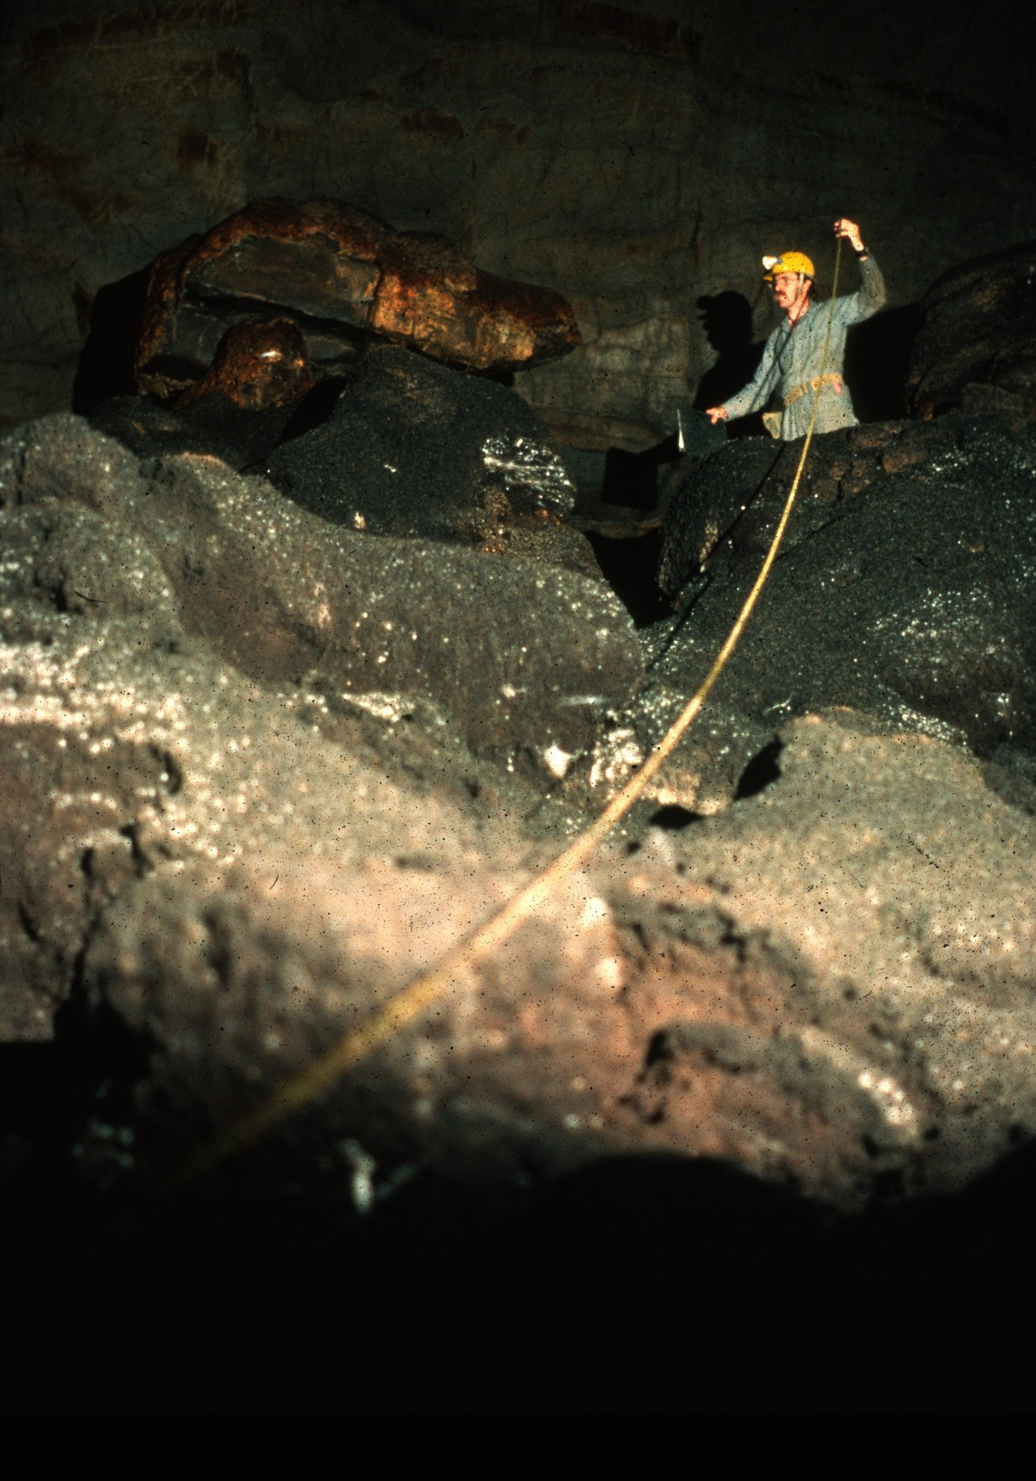
Notes:
Analysis of bat droppings in caves and tests of the bats themselves recently have revealed dangerous levels of environmental contaminants that threaten their survival.

Slide 28
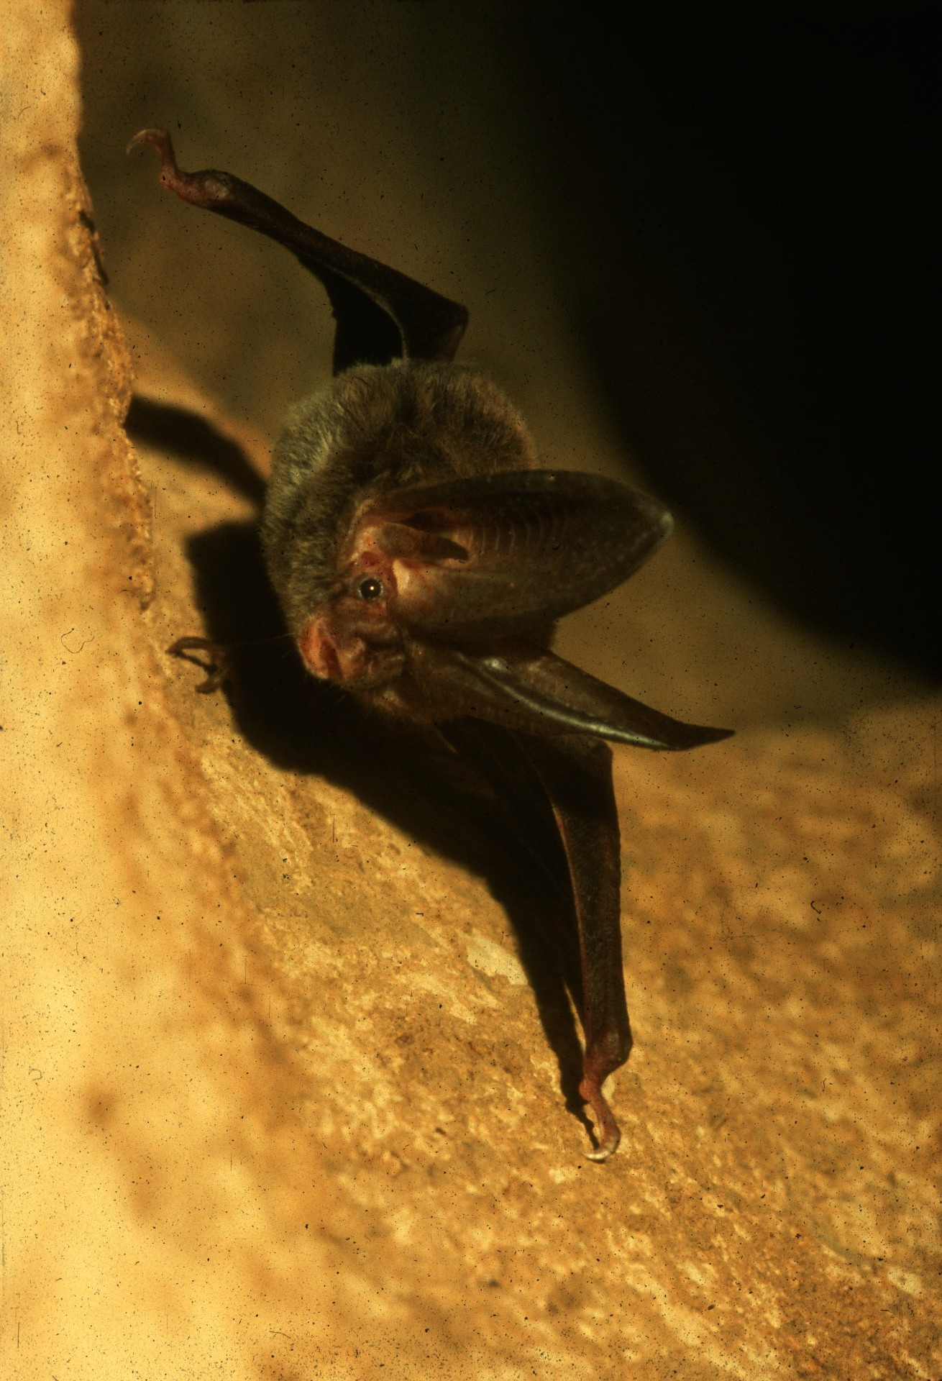
Notes:
Several American bat species have become so severely threatened in recent years that they have been listed as endangered and are now protected under the Endangered Species Act. In the Continental United States, these species include the Indiana Bat, Gray Bat, and the Ozark and Virginia Big-eared Bats. The unique appearance of this Big-eared Bat makes him a target for collectors and souvenir hunters.

Slide 29
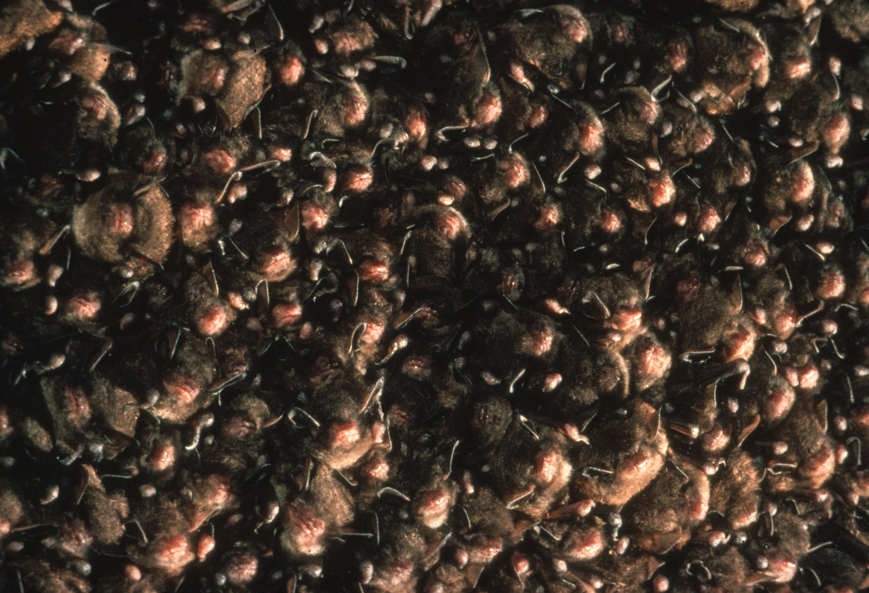
Notes:
These Indiana Bats must cluster densely in a cold cave to maintain proper temperatures with minimum energy expenditure. Of all available caves, only a few are suitable for their hibernation. Because these bats must congregate in a great numbers in relatively few caves, they are very vulnerable to destruction. Indiana Bats have suffered rapid population declines and are in danger of becoming extinct, mostly because of human disturbance.

Slide 30
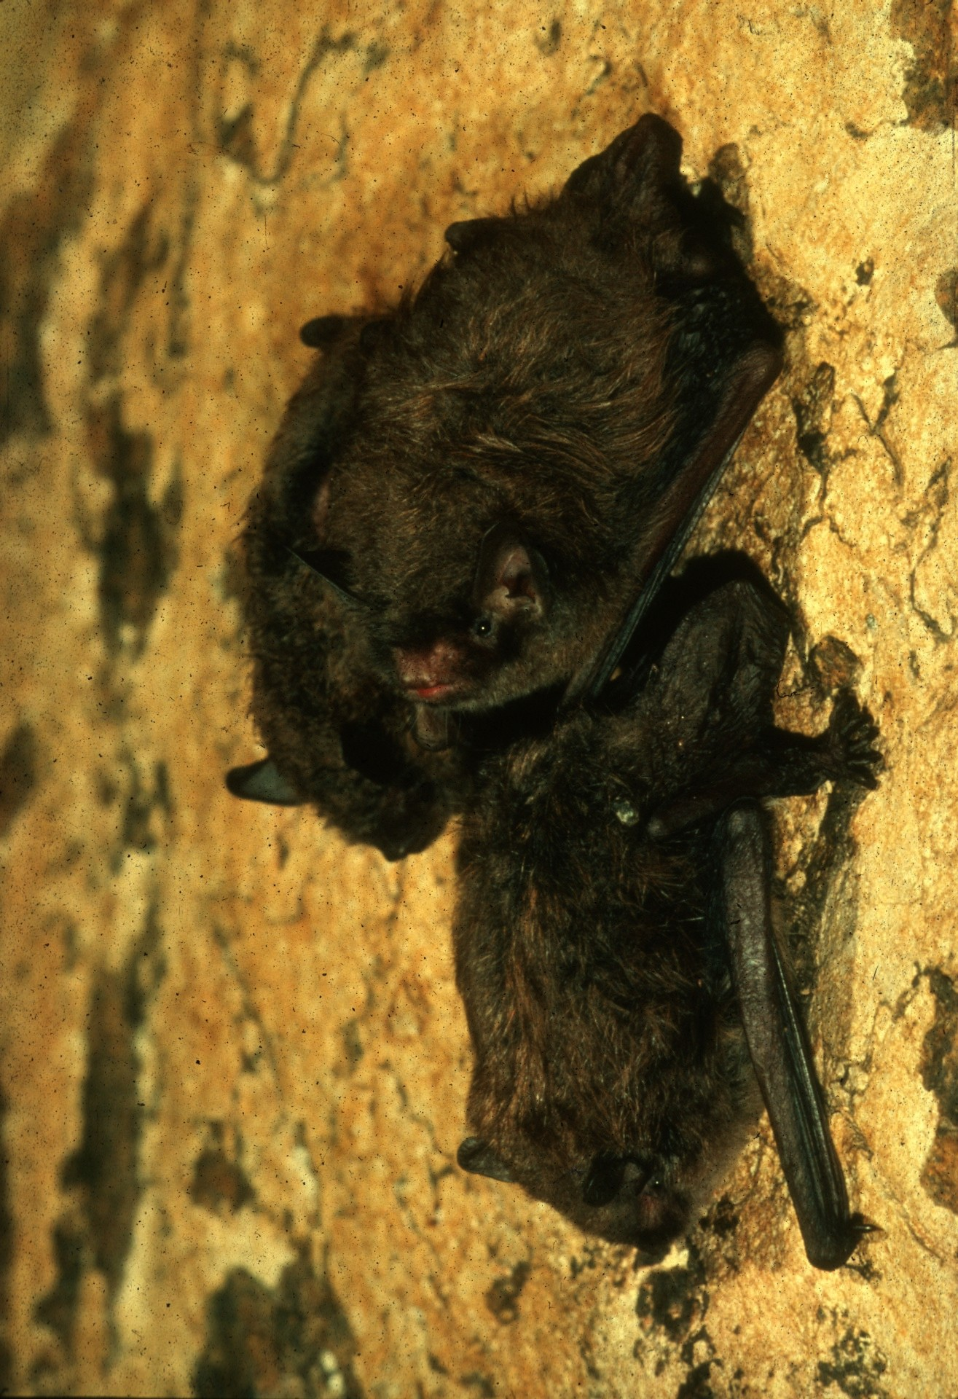
Notes:
Human entry into hibernation caves disturbs the bats. Their increased heart rate and arousal causes these and other bats to waste up to 10 to 30 days supply of stored fat reserves per disturbance. Repeated disturbances have caused entire hibernating populations to die.

Slide 31
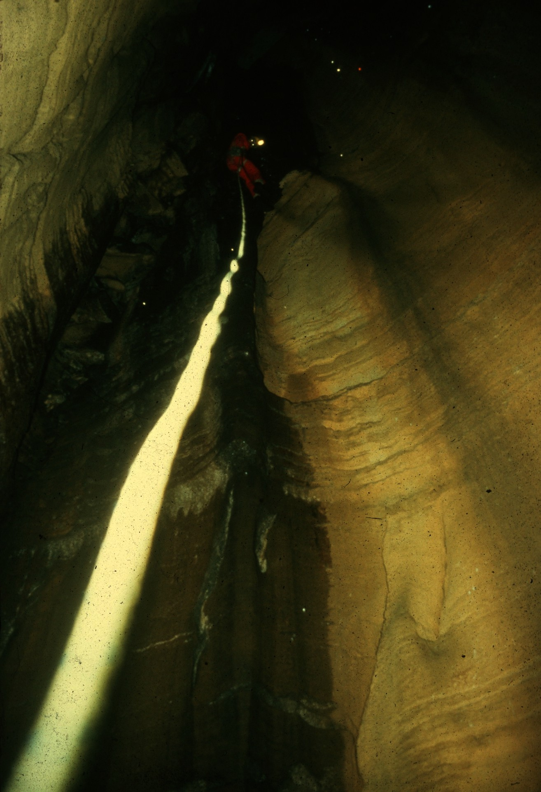
Notes:
Some endangered bats long avoided human disturbance by taking refuge in deep, hard to reach caves. Recently, underground climbing techniques have allowed scientists to discover these bats in their last chance retreats. Unfortunately, modern caving techniques also have dangerously increased human disturbance of these bats.

Slide 32
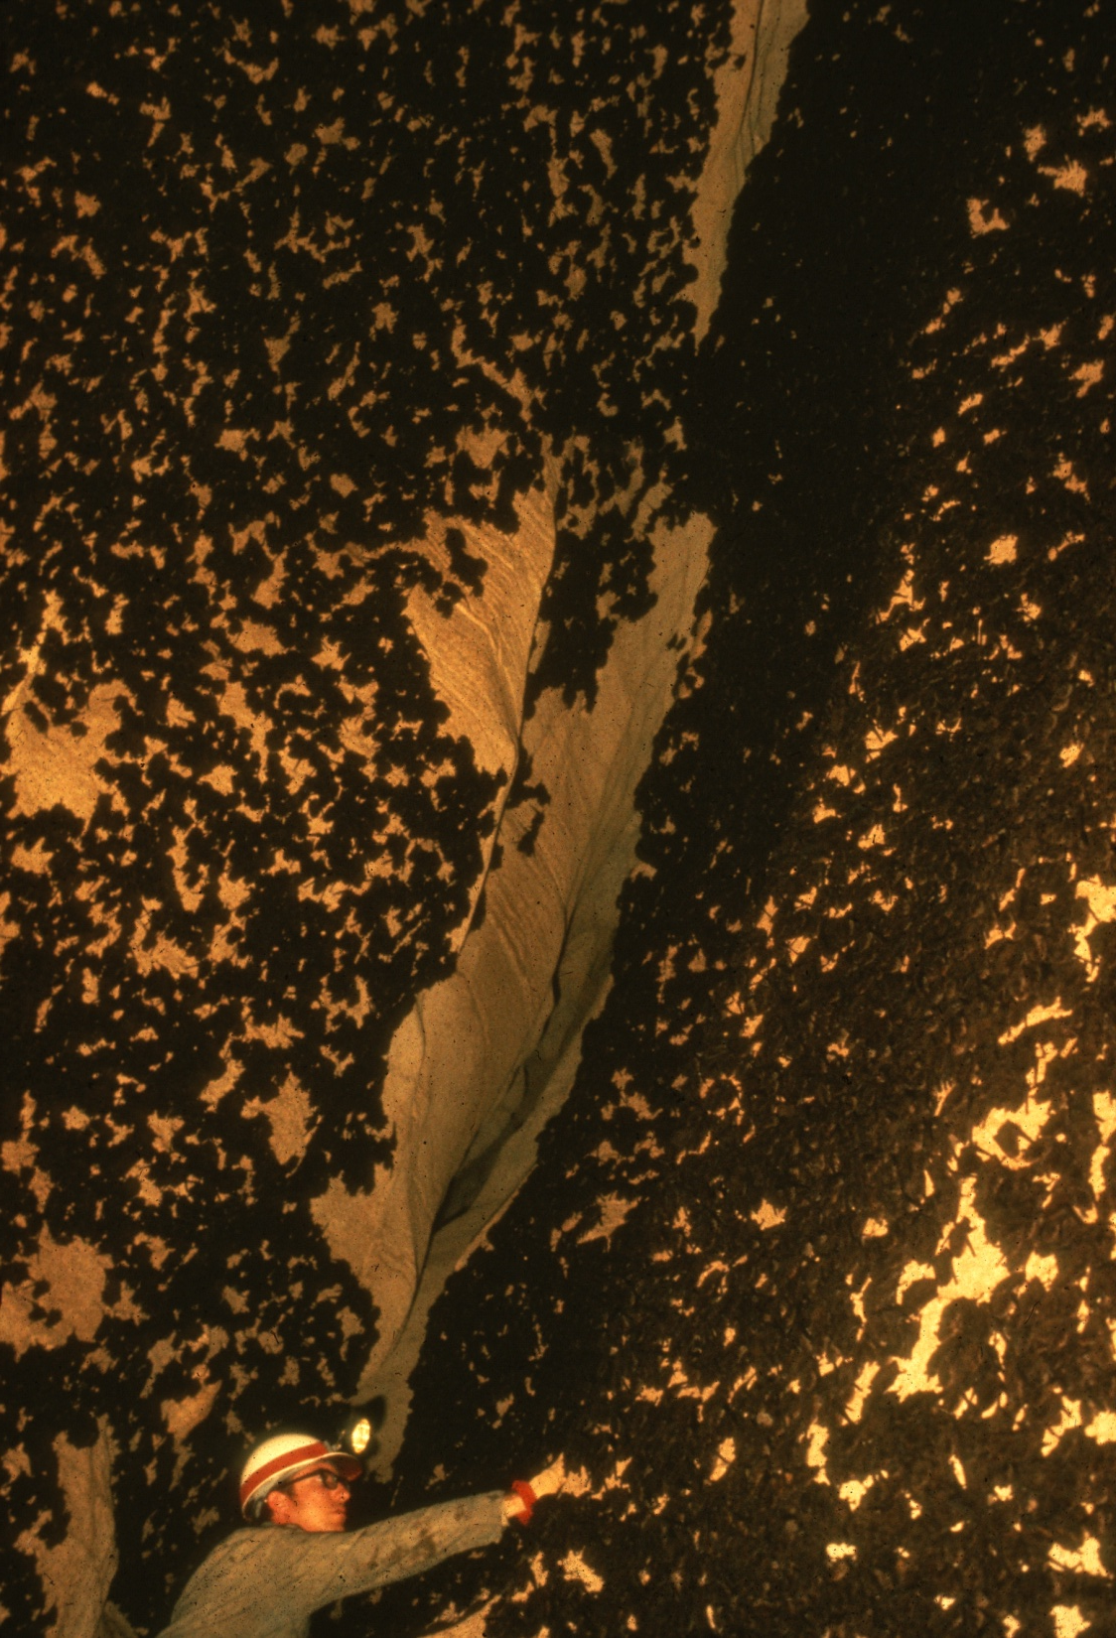
Notes:
Caves suitable for Gray Bat hibernation are rare, and a large proportion of remaining populations must roost in only a few caves. In fact, about two-thirds of all known Gray Bats winter in this one cave in northern Alabama. This important hibernation cave recently was acquired and is not protected by the U. S. Fish and Wildlife Service.

Slide 33
Notes:
To determine annual roosting and habitat requirements and to plan conservation measures, individual Gray Bats have been marked and their movements tracked. Brief surveys of these banded hibernating bats help researchers to keep track of survival rates.

Slide 34
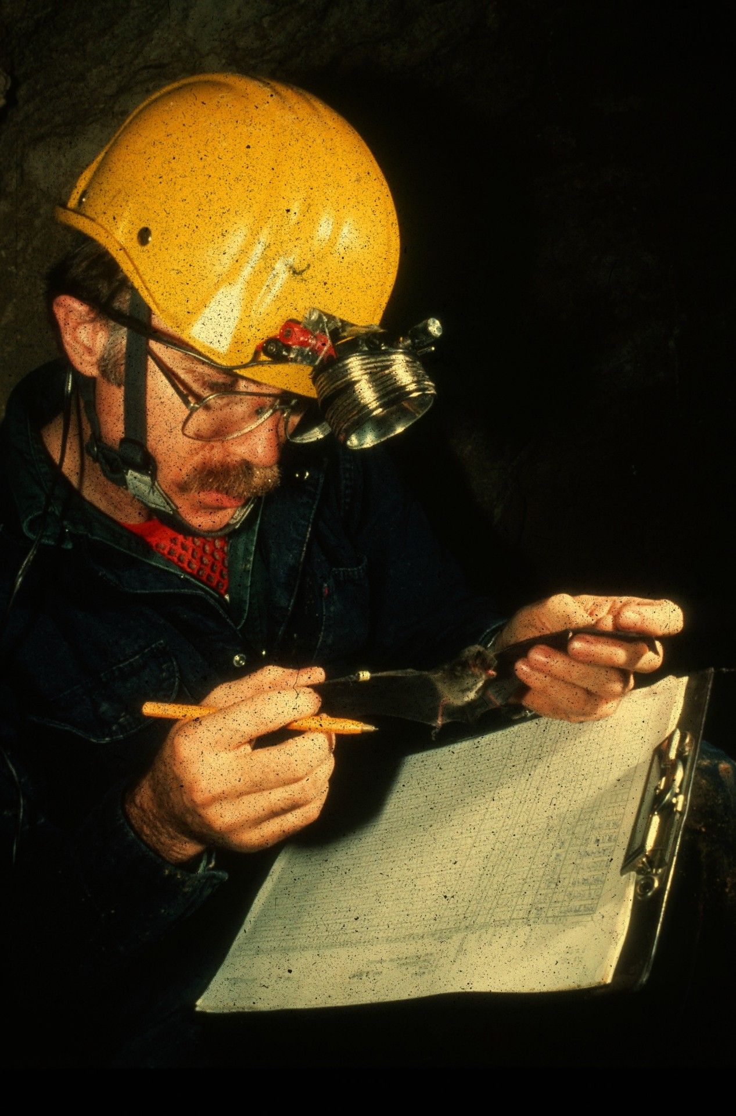
Notes:
Bats are the world’s longest lived small mammals. This 14-year-old male Gray Bat is in good health and my live considerably longer. But, like most bats, this species has only one young per year. And slow reproduction rates, coupled with increasing vulnerability threaten its survival.

Slide 35
Notes:
In spring, Gray Bats must move to extra warm caves located near large rivers or lakes that serve as foraging areas. To find these caves, the bats sometimes must migrate hundreds of miles.

Slide 36
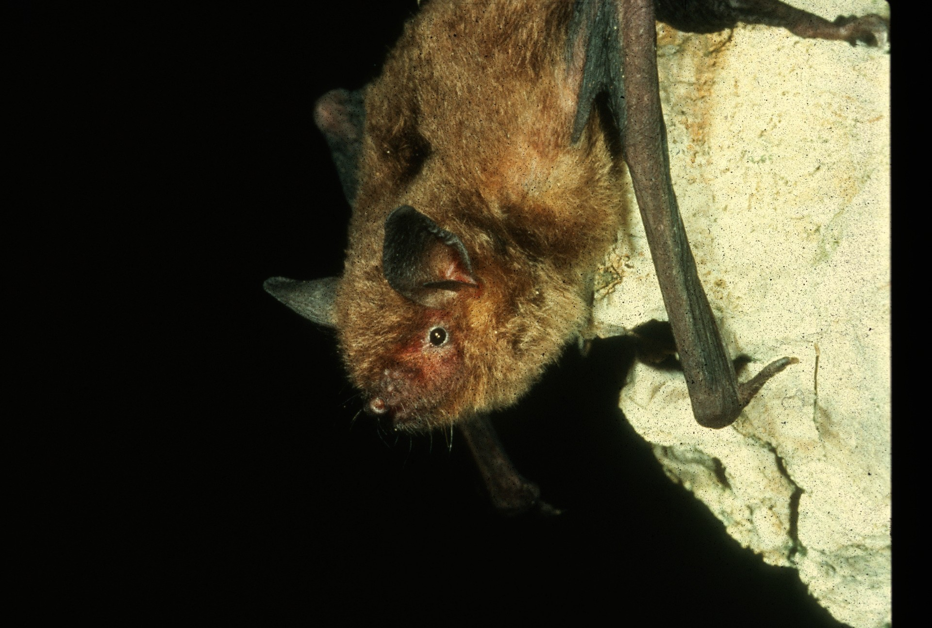
Notes:
Only a few caves trap enough warm air to permit mother Gray Bats to rear their young successfully. And once again, they must concentrate their numbers in vulnerable cave colonies. In the northern part of their range, the warmest roosts are near cave entrances and are especially vulnerable. Human disturbance often forces colonies in these caves to occupy less favorable nursery sites where survival of young is questionable.

Slide 37
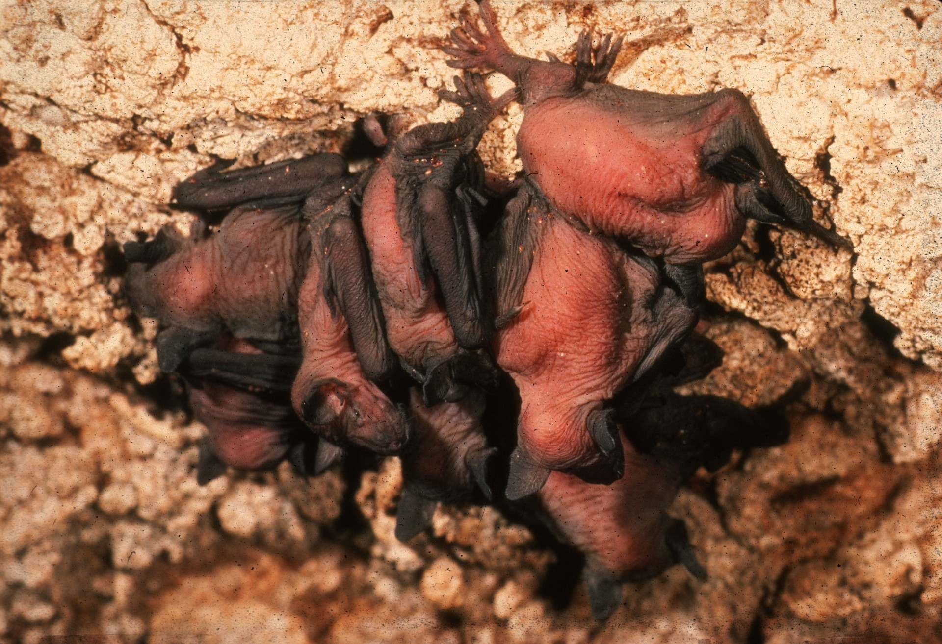
Notes:
These newly born baby Gray Bats will soon join others to form clusters of up to 300 per square foot on the cave ceiling. Dense clusters are needed to stay warm in cool caves. When human disturbance causes colonies to become smaller, mothers must provide extra energy to fuel the growth and heating needs of their babies. As colony size dwindles, the fewer remaining bats may not be able to generate enough heat to rear their young, and the colony may become extinct.

Slide 38
Notes:
In this cave, researchers use a special trap to capture Gray Bats unharmed as they leave the cave to feed.

Slide 39
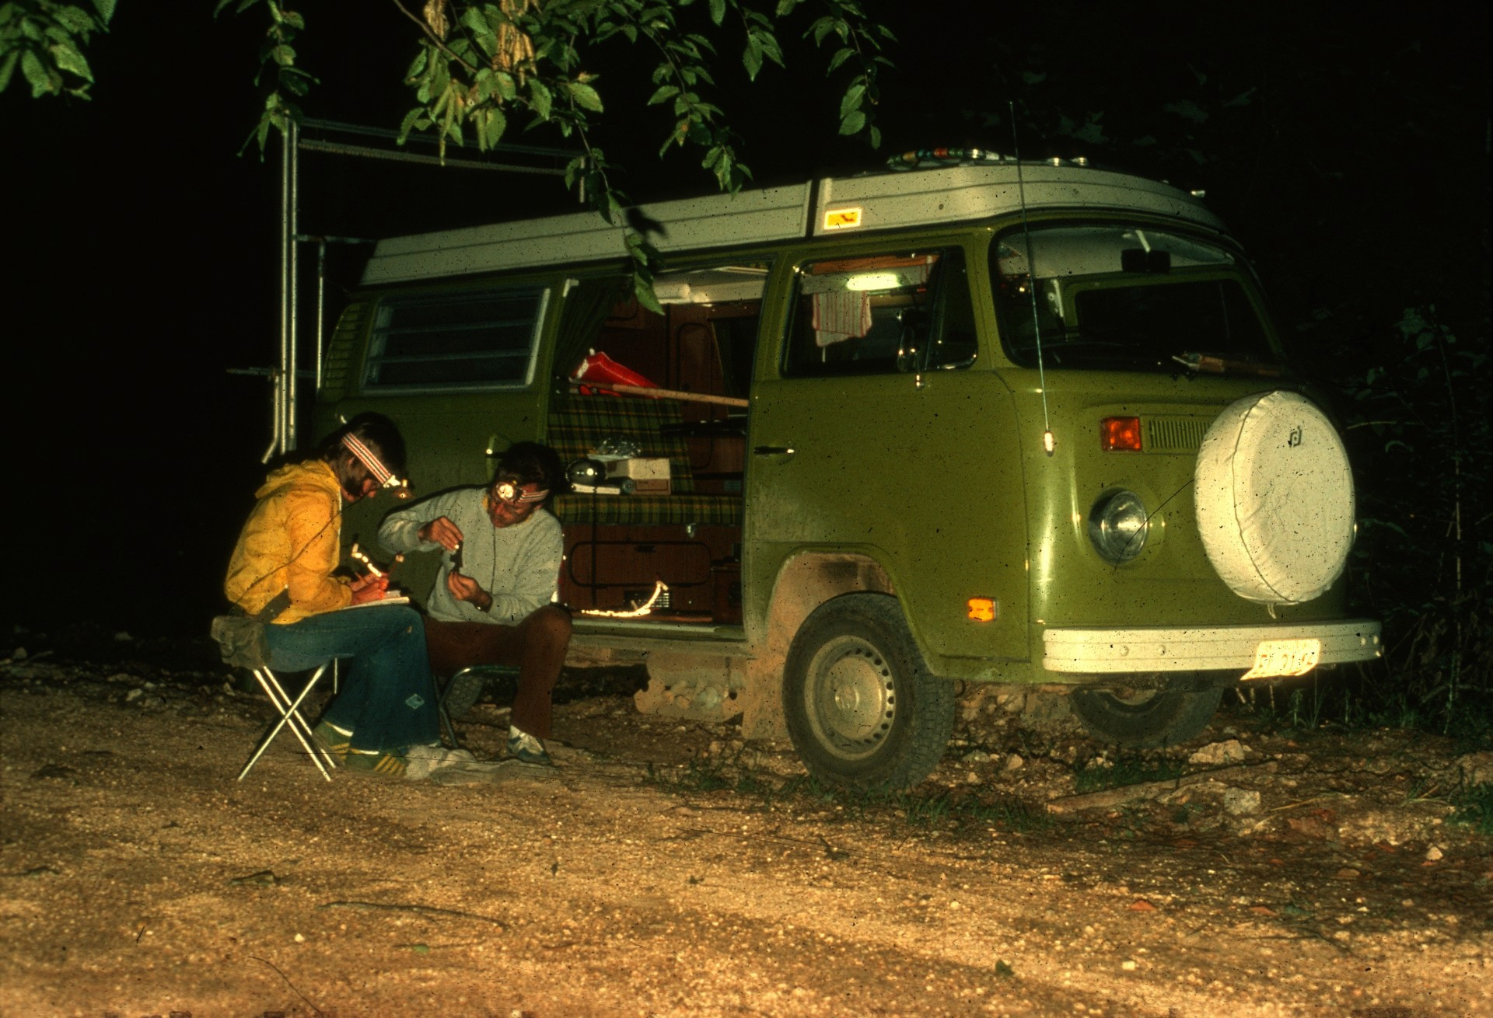
Notes:
Captured bats are banded with a personal ID code number. This one was marked with e color coded reflective band for aerial identification.

Slide 40
Notes:
The band will enable researchers to follow it during its nightly travels to feed.

Slide 41
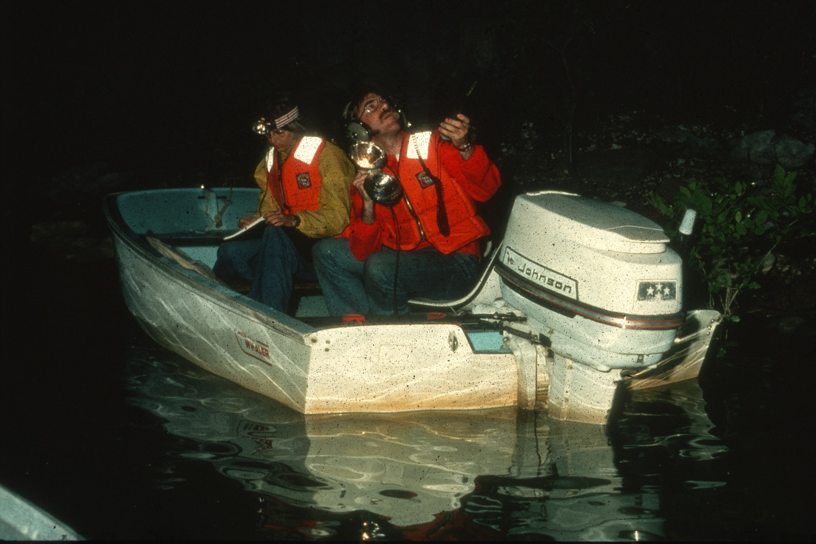
Notes:
Since Gray Bats feed over water, scientists can follow them in boats to look for their color coded arm bands with powerful spot lights. Such studies who that these bats feed in certain areas that are more productive of aquatic insects such as mayflies.

Slide 42
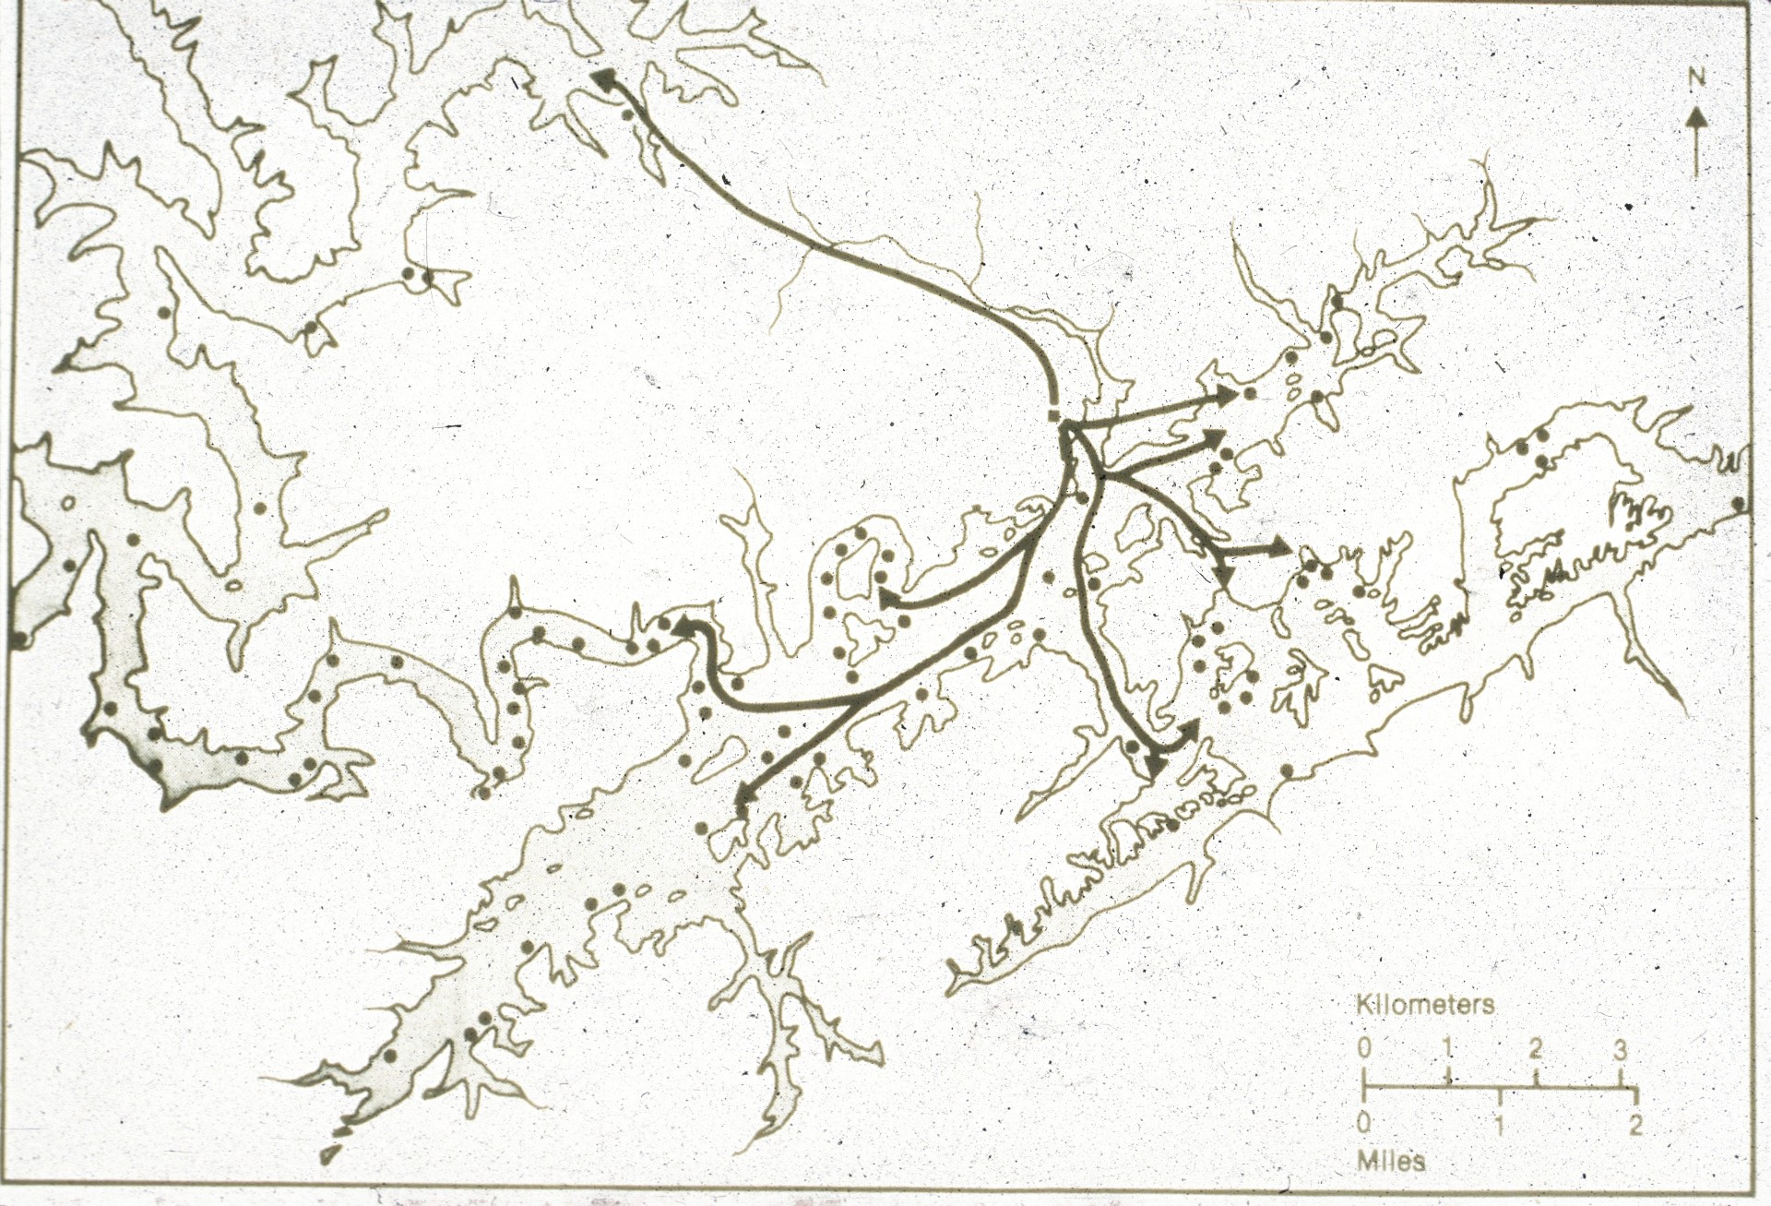
Notes:
This map shows where members of one colony went and the distances to their various feeding sites. Long distances traveled between roosts and feeding areas greatly influence growth and survival rates, illustrating how habitat loss contributes to decline.

Slide 43
Notes:
Insects sampled at feeding areas help determine prey preferences. Observations of bat feeding behavior at such sites show that Gray Bats can identify and communicate with each other as individuals. They even stake out private feed territories over the water and admit only select acquaintances to share feeding rights.

Slide 44
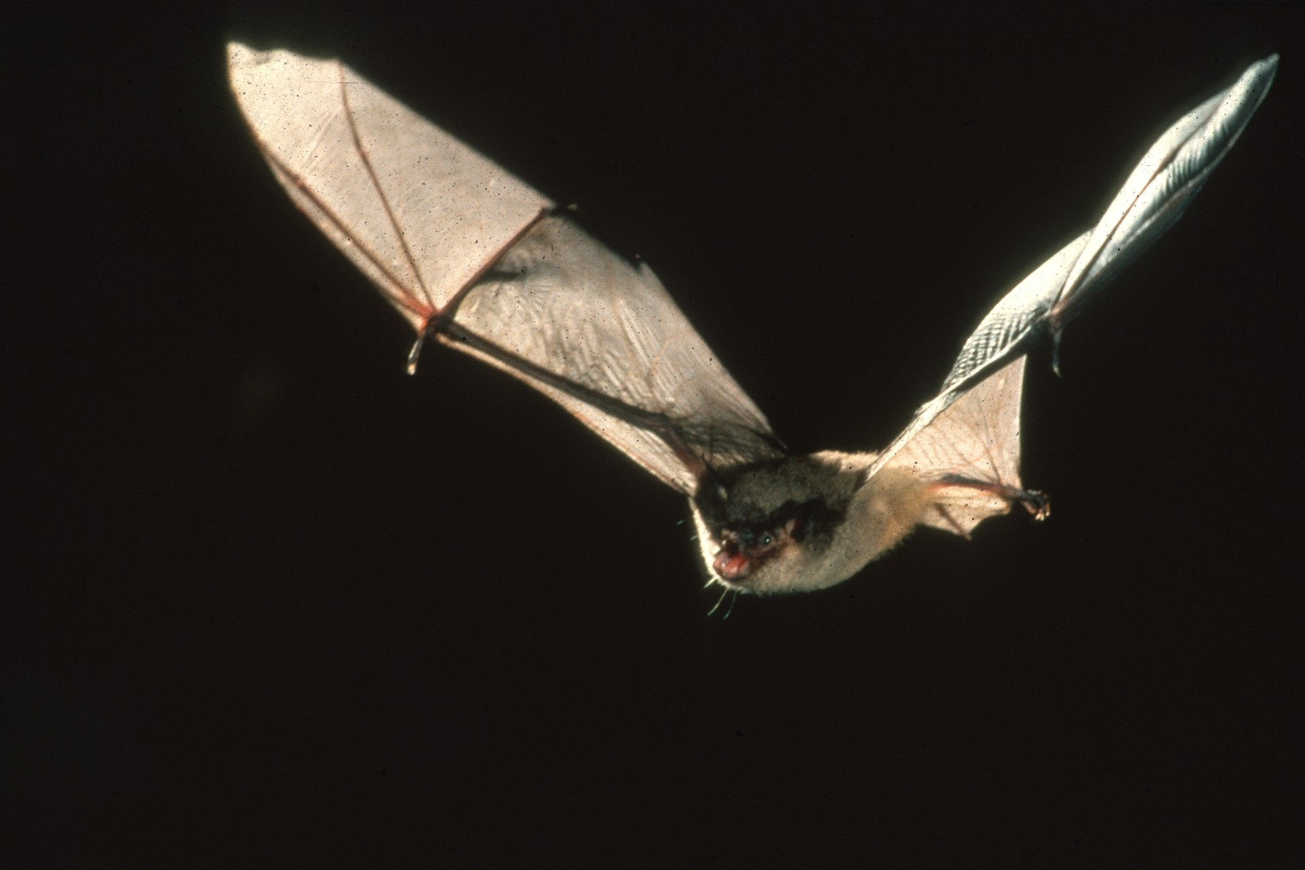
Notes:
Individual Gray Bats may capture up to 3000 or more insects in a single night, and large colonies eat a tone or more nightly. In so doing, the bats unfortunately may build up toxic levels of pesticide residues in their systems. This adversely affects bat survival as does pollution and siltation of waterways in feeding areas. Most harm, however, appears to come from direct human disturbance. A Kentucky study documented an 89% decline overall, and other studies in Tennessee and Alabama showed that even the healthiest of remaining Gray Bat colonies had declined by 54% in less than a decade. These alarming declines were highly correlated with intensity of human disturbance. One disturbed colony of 300,000 Gray Bats became virtually extinct in only three years. Threats to bat survival and evidence of population declines in many species are widespread. Some populations have disappeared entirely in recent years, and thousands of bats at a time continue to be killed intentionally by misinformed people.

Slide 45
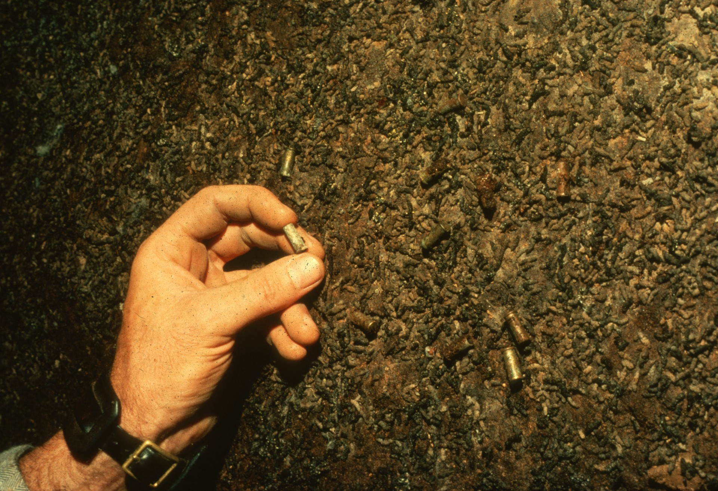
Notes:
These empty cartridge casings found under a former nursery roost tell their own all too common story. Explosives and fires have been set in caves, and guns have been fired at roosting or emerging bats.

Slide 46
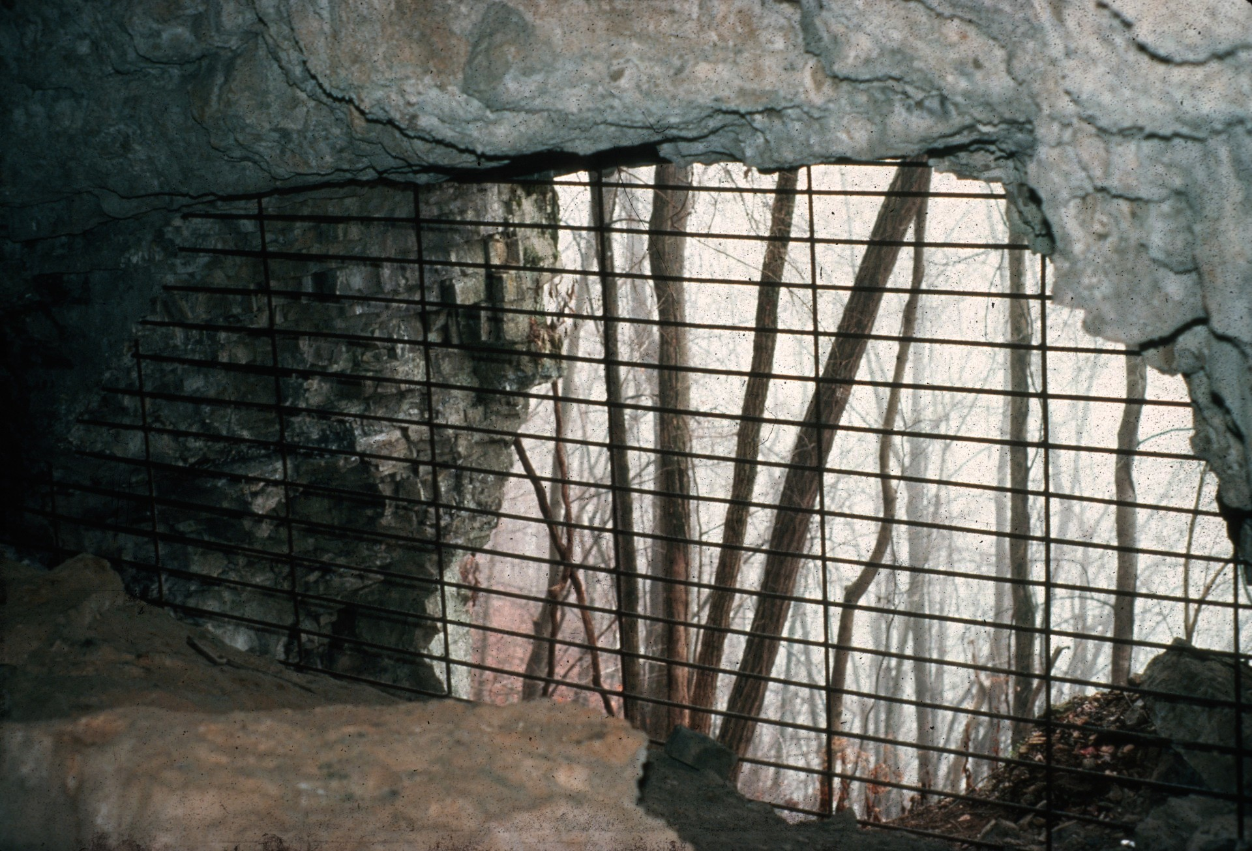
Notes:
Specially designed gates and fences have been used to restrict human entry at some caves, and at many of these sites, bat colonies are not recovering to former numbers.

Slide 47
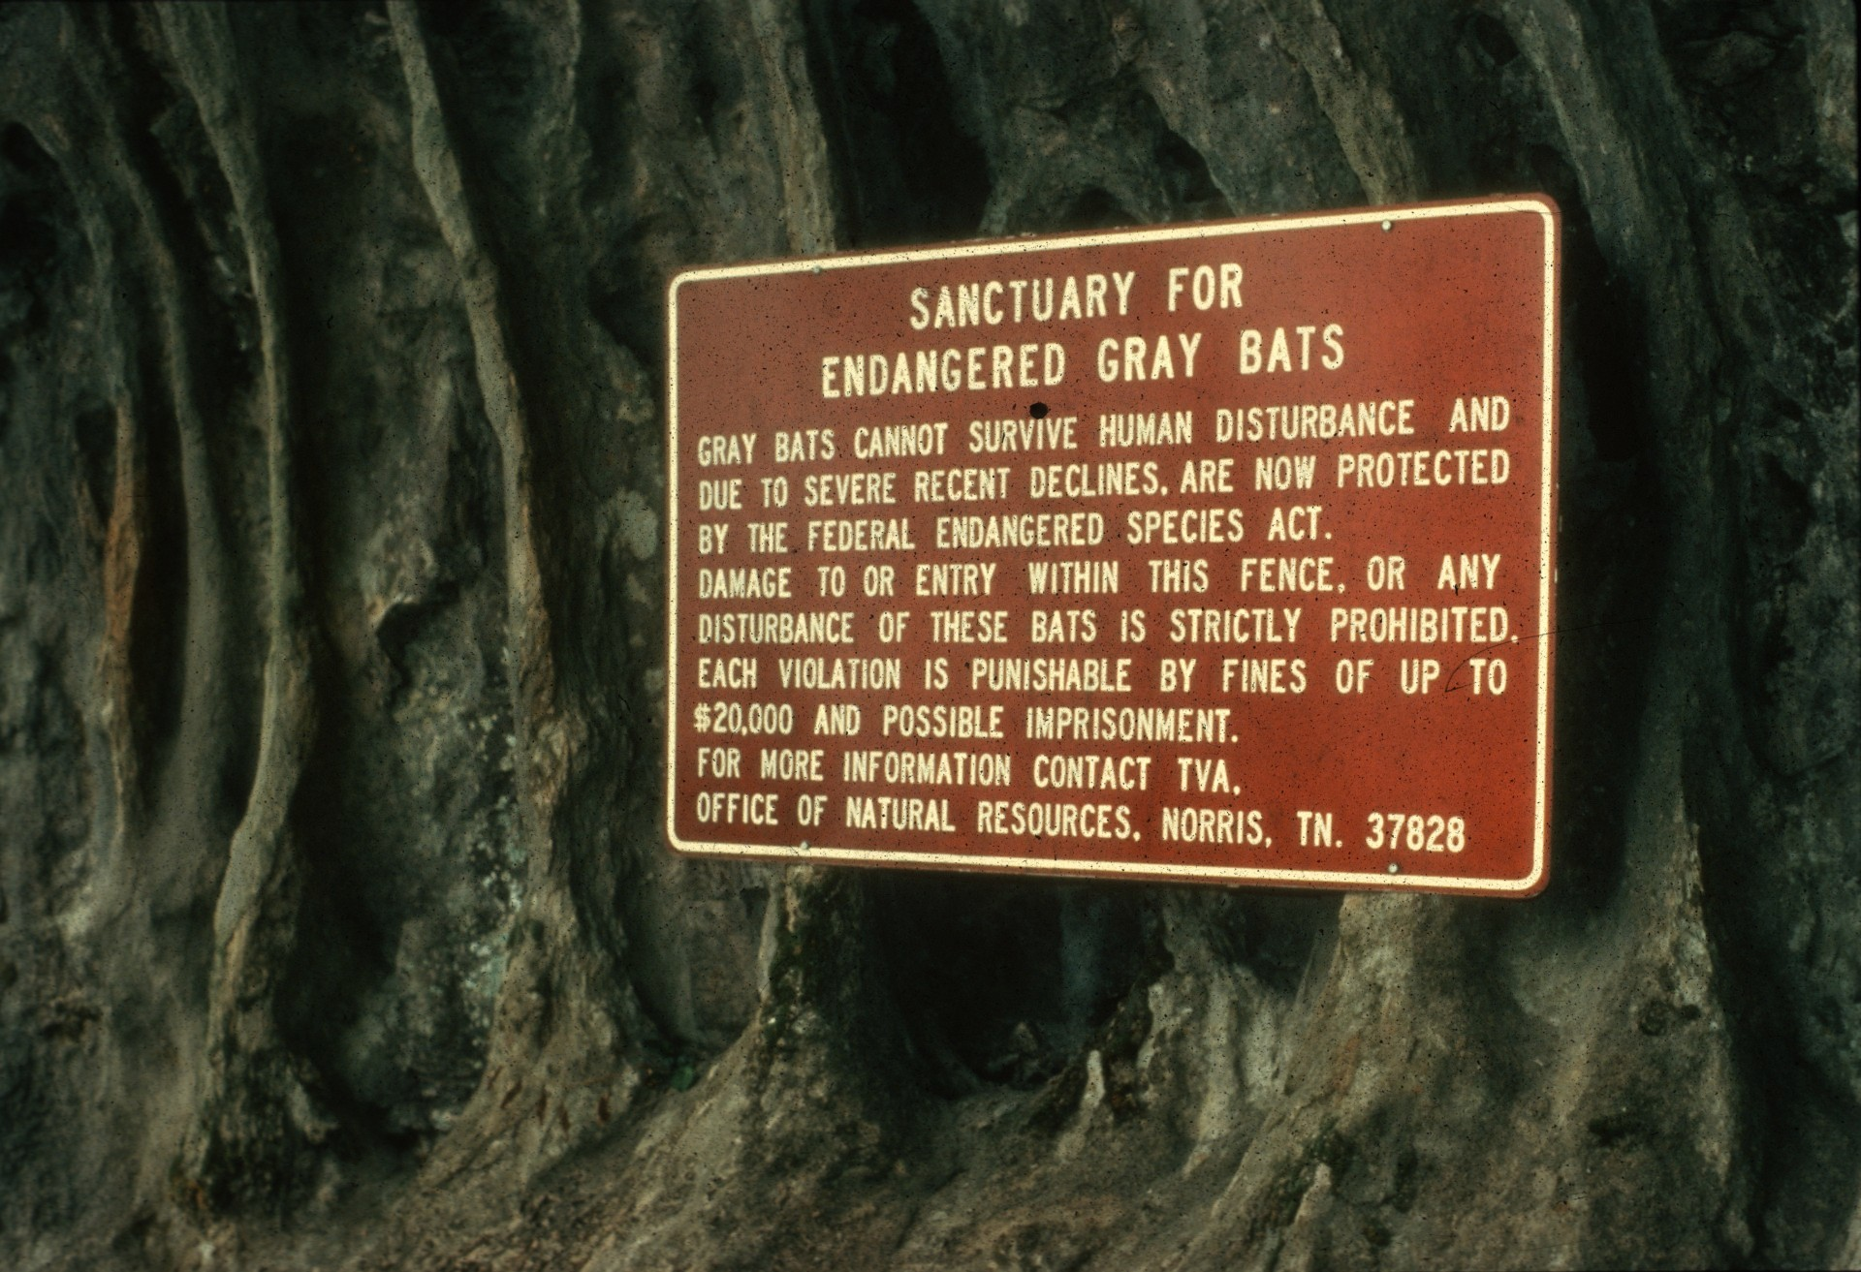
Notes:
Essential bat habitats are being posted, and federal laws now mandate stiff fines and prison terms for people who kill or disturb endangered bats. But gate and legal sanctions can be violated. The U. S. Fish & Wildlife Service has produced this program to educate people and gain their cooperation to help protect bats.

Slide 48
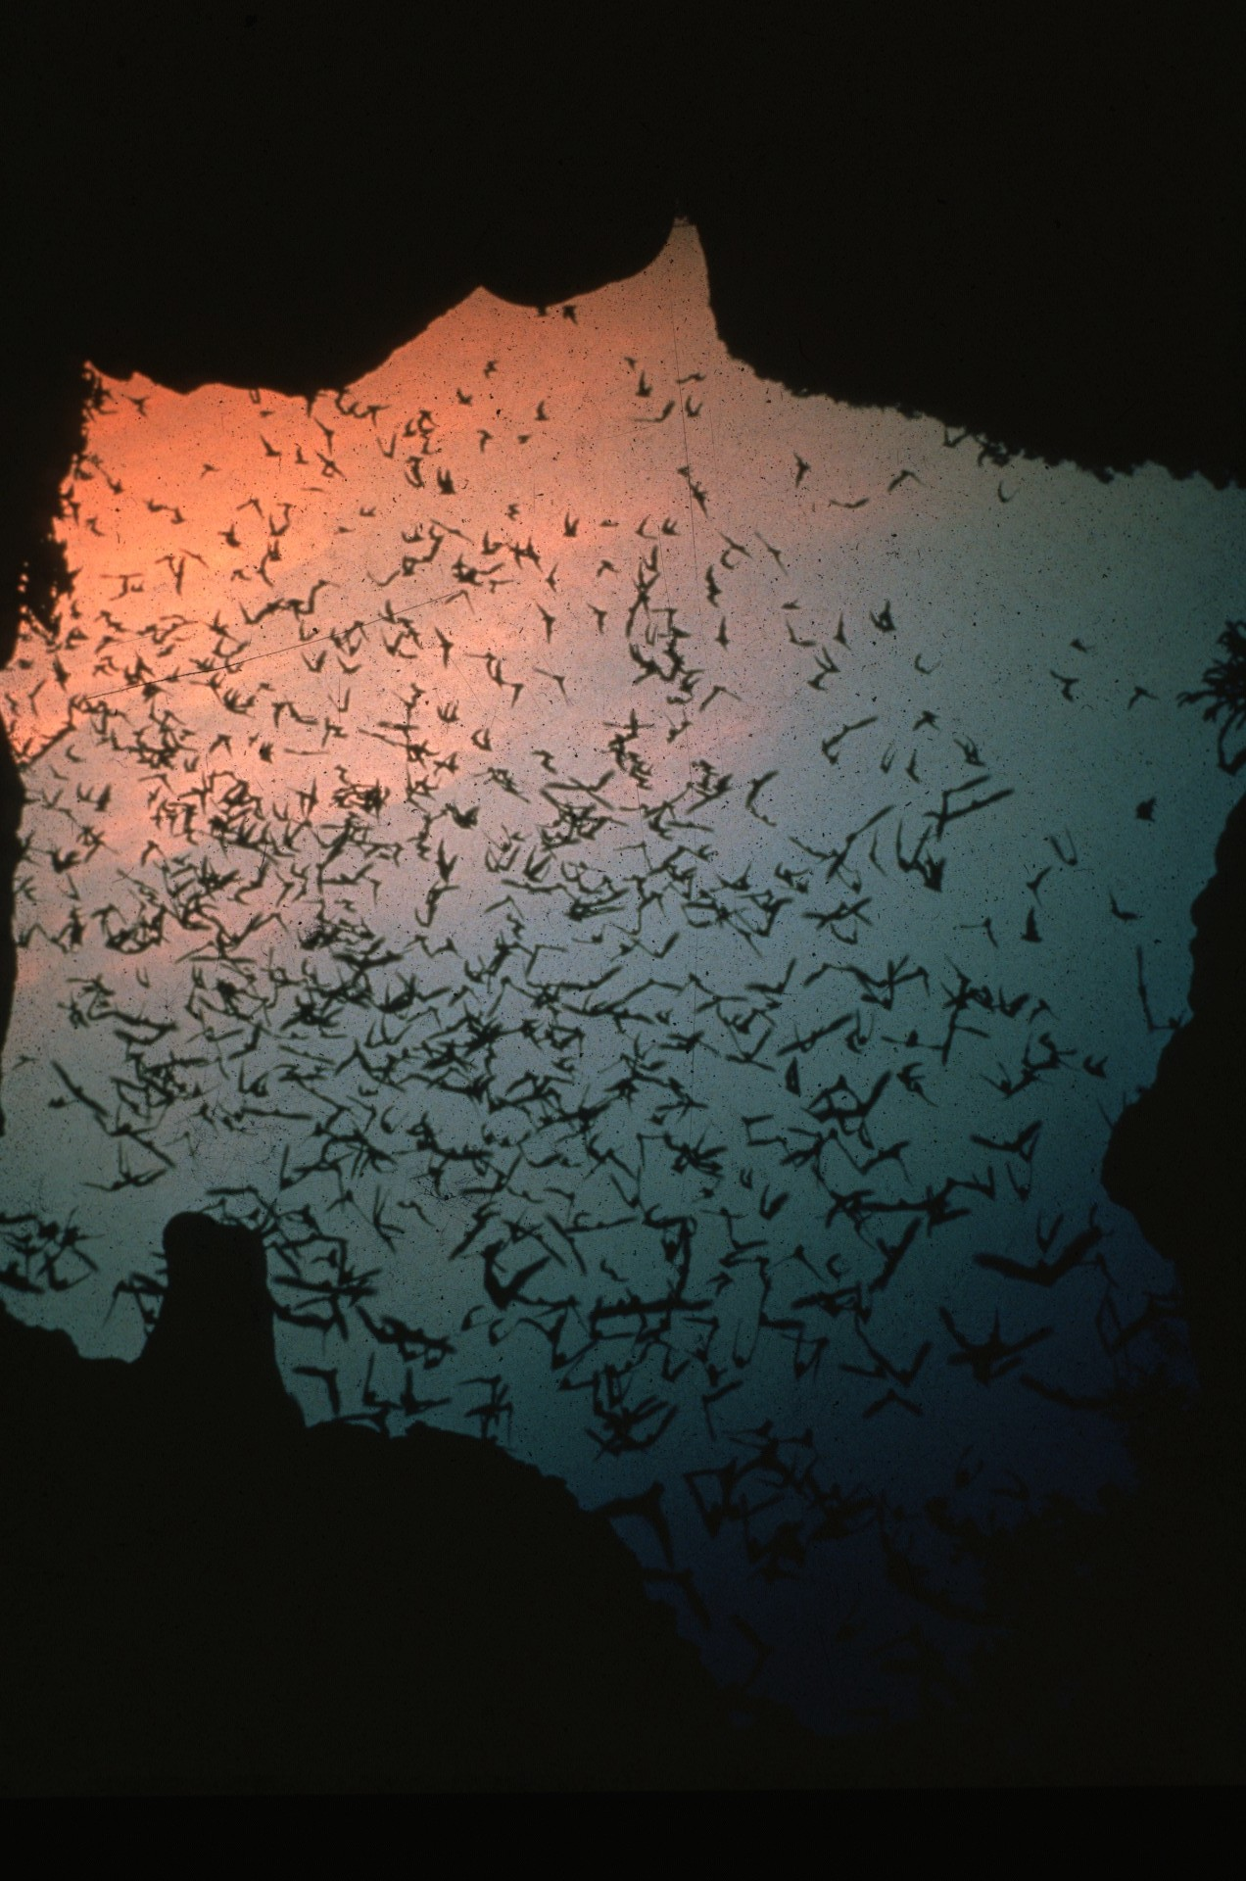
Notes:
Old superstitions and needless fears must be put aside. Only enlightened wildlife management can preserve remaining bat populations for the benefit of future generations.

Slide 49
An NSS Audio-Visual Library Presentation
Saving America’s Bats
Bat Conservation International
and the U. S. Fish and Wildlife Service
Original slide program S403
Slides digitized by David Caudle
PowerPoint program created by Jim McConkey
49 slides, with script in presenter notes
PowerPoint created 2/06/2021
National Speleological Society
6001 Pulaski Pike
Huntsville, AL 35810-1122
256- 852-1300
nss@caves.org
https://caves.org/

